Slide 1
The U.S. Refrigerant Transition:
What you need to know in 2024
January 23, 2024

Slide 2
Introductions

Slide 3
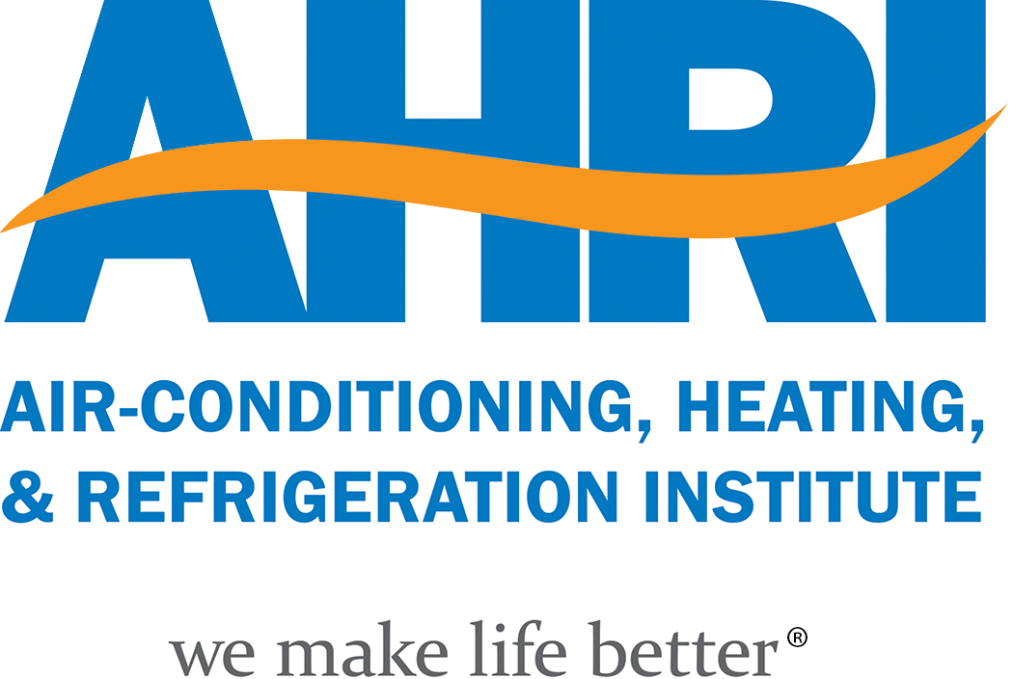

Air-Conditioning, Heating, and Refrigeration Institute (AHRI)
Advocate for 330+ HVACR and water heating manufacturers
Developer of 100+ international industry standards and guidelines
Administer of 40+ certification programs

Slide 4

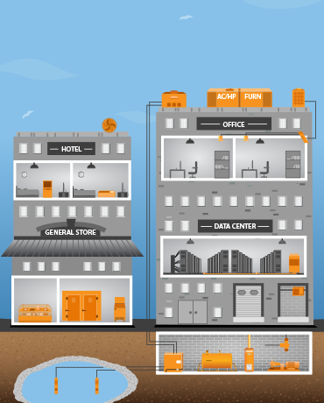
Our Members are Manufacturers
Cooling and heating products for
residential, commercial and industrial applications
central AC &
heating equipment
commercial & industrial
AC, heating & ventilation
equipment
commercial &
industrial refrigeration
equipment
hydronic heating
equipment
components for heating,
AC & refrigeration
systems
water heating equipment

Slide 5
Issues for Discussion Today
Status of American Innovation and Manufacturing (AIM) Act Implementation
EPA’s Technology Transitions (TT) Final Rule
EPA’s Refrigerant Management (Subsection (h)) Proposed Rule
State Building Code Updates for A2Ls/Low-Global Warming Potential (GWP) Refrigerants

Slide 6
U.S. Refrigerant Transition Developments
Congress: Implementing legislation (AIM Act) passed and signed into law and Kigali Amendment ratified by U.S. Senate
EPA: Implementation of the AIM Act is well underway – awaiting the release of the Technology Transitions final rule
Building codes are being updated in states to allow the new refrigerants
Work ongoing with the Department of Transportation and OSHA

Slide 7
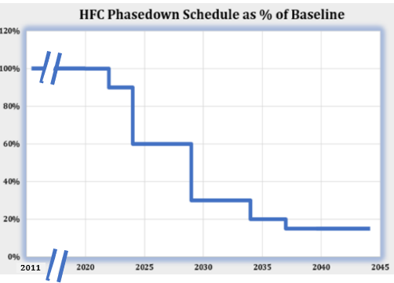
HFC/AIM Act/Kigali Amendment Phasedown Schedule
Mandates phasedown of HFC supply
Authorizes sector transitions
Refrigerant management including recovery and reclaim
2011-2013 baseline:
2022: 10% reduction
2024: 40% reduction
2029: 70% reduction
2034: 80% reduction
2036: 85% reduction

Slide 8
HFC Regulatory Outlook
HFC production and consumption phase down
Technology Transitions (TT) Final Rule
Refrigerant management (Subsection (h)) Proposed Rule
SNAP approvals and use conditions
California, Washington, and New York

Slide 9
HFC Phase Down
EPA finalized allocation methodology for 2024-2028
HFC supply reduced to 60 percent of baseline in 2024
Allowance allocations based mostly on historical activity
Commerce Department also cracking down on ‘dumping’
Isolated legal challenges opposed by industry groups

Slide 10
Technology Transitions
EPA finalized Technology Transitions rule in October 2023
  Sets GWP limits for new equipment in 2025-2028
Different requirements for ‘products’ and ‘systems’
Components for servicing/repair exempt
Interim Final Rule starts ‘fine tuning’ process

Slide 11
Refrigerant Management
EPA proposed new refrigerant management rules in 2023
Leak detection/repair rules for commercial equipment
Reclaim mandates for initial charge and servicing
No new certification standards for technicians
Wide range of views on recovery/reclaim policy goals

Slide 12
SNAP
SNAP 25 finalized in 2023, approving several A2Ls
SNAP 26 proposed in 2023 and expected final in 2024
SNAP 27 possible by end of 2024 or early 2025
Use conditions need to harmonize with new standards
Provisional approval already issued for many A2Ls

Slide 13
States
California implementing its own HFC regulations
California also developing further HFC restrictions
Washington finalized HFC regulations in November 2023
New York proposed new HFC rules in December 2023
Other states not active on direct HFC restrictions for now

Slide 14
State Building Code Adoption
45 states have approved the use of A2L refrigerants in some capacity
  Through a combination of code updates, legislation, and letters of interpretation
  These changes are effective today in 43 of these states

Slide 15
State Building Code Adoption
Priorities for 2024
  Alaska, Hawaii, Massachusetts, Nevada, Michigan
    Alaska – Legislation
    Hawaii – Legislation
    Massachusetts – Legislation and State Building Code being updated in 2024
    Nevada – Jurisdictional Building Codes being updated in 2024
    Michigan – Commercial refrigeration changes approved in code, seeking letter for residential air conditioning

Slide 16
State Building Code Adoption
Priorities for 2024
  U.S. Territories
    AHRI working with each of the U.S. territories to update their codes
  Some states have approved A2L use in residential air conditioning but not for commercial refrigeration
  Updating state codes to reference the latest editions of ASHRAE 15, ASHRAE 34, UL 60335-2-40, and UL 60335-2-89
  Warehousing – aligning with 2024 IFC and NFPA 1

Slide 17
Education and Awareness
AHRI is committed to working with other organizations to raise awareness of the updated model codes
  Interactive Map
  Partnering with ICC, PHCC, HARDI, and ACCA to produce a series of short videos on the refrigerant transition
  Creating a new website to serve a hub of A2L refrigerant information
    www.saferefrigeranttransition.org
  Meeting with AHJs to discuss questions and concerns

Slide 18
Interactive A2L Building Code Map
Let’s look at the map!

Slide 19
Who at AHRI to ask for information?
sslater@ahrinet.org for Policy Information
tdeary@ahrinet.org for Building Code Information

Slide 20
Thank you!

