Slide 1
VRF Test Procedure Update
Overview of AHRI 1230-2023
Performance Rating of Variable Refrigerant Flow (VRF)
Multi-Split Air-conditioning and Heat Pump Equipment
Walt Hunt, Manager of Environmental Research
Daikin Comfort Technologies North America

Slide 2
Agenda
Scope of AHRI 1230-2023
Key changes from prior test procedure
Sensible Heat Ratio (SHR) limits
Controls Verification Procedure (CVP)
Example calculations

Slide 3
Scope of AHRI 1230-2023
AHRI 1230-2023 applies to:
VRF Multi-Split Air-Conditioners and VRF Multi-Split Heat Pumps.
Including VRF Air-source systems with Cooling Capacity ≥ 65,000 Btu/h.
Including VRF Water-source systems of any Cooling Capacity.
Including VRF with and without heat recovery.
Including Ducted, Non-Ducted, and Mixed Indoor Units
VRF = Variable Refrigerant Flow

Slide 4
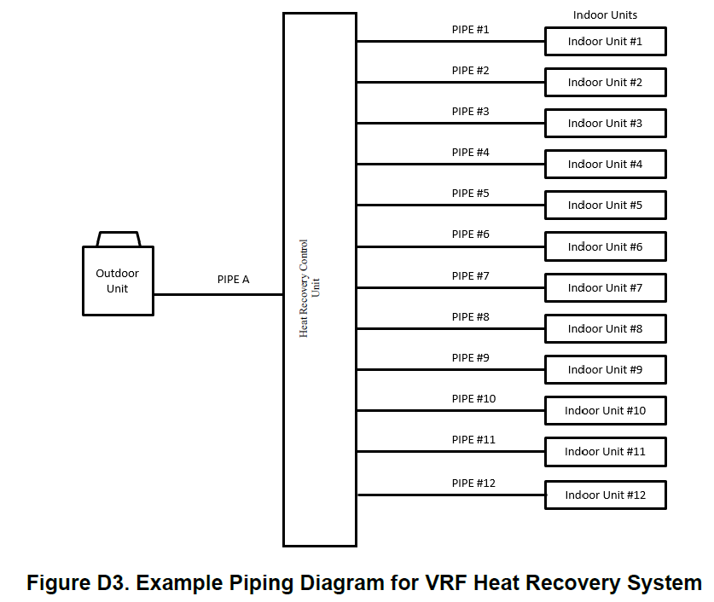
Variable Refrigerant Flow (VRF) System
1230-2023 Definition of Variable Refrigerant Flow System:
An engineered direct expansion (DX) air-conditioning of Heat Pump multi-split system that incorporates the characteristics and components:
  A single refrigerant circuit that has common piping
  network to multiple indoor units;
  Single Module or Combined Module Outdoor Units;
  Two or more Indoor Units;
  Three or more steps of capacity; and
  A zone temperature control device such as a thermostat.

Slide 5
Standard Rating Tests for VRF Air-Source Systems
Cooling Operation
Single-Point EER
Multi-Point IEER
IEER Test Points for Air-Cooled Equipment
 | Outdoor Dry-bulb | IEER Weighting
100% Full-load (EER) | 95.0°F | 2.0%
75% Part-load | 81.5°F | 61.7%
50% Part-load | 68.0°F | 23.8%
25% Part-load | 65.0°F | 12.5%
Indoor Condition: 80°F dry-bulb; 67°F wet-bulb

Slide 6
What’s the Significance of AHRI 1230-2023?
AHRI 1230-2023 became effective for AHRI VRF Certification Program on January 1st, 2024.
Compared to AHRI 1230-2014 with Addendum 1 (previous test procedure for AHRI VRF program), there are major revisions for determining IEER and EER for a VRF system.
AHRI 1230-2023 is more stringent than the previous VRF test procedure.
AHRI 1230-2023
AHRI 1230-2014 (with Addendum 1)
IEER, EER
IEER, EER
≠

Slide 7
What’s the Significance of AHRI 1230-2023?
Major Test Procedure Revisions from Prior Standard
 | AHRI 1230-2014 (with Addendum 1) | AHRI 1230-2023
Sensible Heat Ratio (SHR) Limits | None | SHR Limit at 100% Full-load test SHR Limit at 75% Part-load test
Controls Verification Procedure (CVP) | None | Ensures compressor speed(s), outdoor fan speed(s), and outdoor valve position(s) during testing align with native controls.

Slide 8
Transition to AHRI 1230-2023
Example Impact to IEER Metric
In 2019 as part of DOE negotiated rulemaking process, multiple VRF manufacturers through AHRI evaluated impact of new test procedures through testing or simulation. These sample VRF systems provide an example of the rated efficiency impact of the new test procedure (AHRI 1230-2023).
IEER Impact of Revised Test Procedures – 2019 AHRI Study
 | IEER AHRI 1230-2014 (with Addendum 1) | IEER AHRI 1230-2023 | Percent Reduction
Average of Air-Cooled VRF Equipment Examined | 21.99 | 18.87 | 13.1%
Range of Air-Cooled VRF Equipment Examined | 15.61 – 25.68 | 15.14 – 22.62 | 2.5 – 25.6%
For a specific VRF system, IEER and EER impact of new test procedure will vary.

Slide 9
Transition to AHRI 1230-2023
Example Impact to EER Metric
In 2019 as part of DOE negotiated rulemaking process, multiple VRF manufacturers through AHRI evaluated impact of new test procedures through testing or simulation. These sample VRF systems provide an example of the rated efficiency impact of the new test procedure (AHRI 1230-2023).
EER Impact of Revised Test Procedures – 2019 AHRI Study
 | EER AHRI 1230-2014 (with Addendum 1) | EER AHRI 1230-2023 | Percent Reduction
Average of Air-Cooled VRF Equipment Examined | 11.6 | 9.8 | 15.8%
Range of Air-Cooled VRF Equipment Examined | 10.6 – 13.3 | 8.8 – 12.1 | 7.9 – 20.1%
For a specific VRF system, IEER and EER impact of new test procedure will vary.

Slide 10
ASHRAE 90.1-2022
Minimum Efficiency Requirements for VRF Heat Pumps
Size Category | Subcategory | Minimum Efficiency
≥65,000 Btu/h and <135,000 Btu/h | VRF multi-split system | 11.0 EER Before 1/1/2024 10.3 EER On or after 1/1/2024
 | VRF multi-split system with heat recovery | 10.8 EER Before 1/1/2024 10.1 EER On or after 1/1/2024
… | … | …
… | … | …

Slide 11
Sensible Heat Ratio Limits in AHRI 1230-2023
Sensible Heat Ratio (SHR) Limit for 100% and 75% test points (IEER)
 | Sensible Heat Ratio (SHR) Limit
100% Cooling Load Test at 95.0°F | ≤ 0.82
75% Cooling Load Test at 81.5°F | ≤ 0.85

Slide 12


Test Adjustments and EER Adjustments (as needed) if Sensible Heat Ratio Limits not Achieved in AHRI 1230-2023
Step 1: Test Adjustments if SHR Limit not Achieved
Allowable Critical Parameter Adjustment for Meeting SHR Limits (Section 6.3.3.2)
Incrementally increase compressor speed up to +3% capacity tolerance.
Step 2: Test EER Penalty if SHR Limit not Achieved through Step 1

Slide 13
Test Adjustments and EER Adjustments (as needed) if Sensible Heat Ratio Limits not Achieved in AHRI 1230-2023
Example 5 from Appendix G from AHRI 1230-2023
Example of SHR test and EER penalty adjustments at 100% Load, 95°F test point.
SHR Limit of 0.82 at test point.
Step | SHR | EER
Initial Test Results | 0.86 | 11.14
Step 1: Adjusted Test Result | 0.84 | 11.08
Step 2: EER Penalty | 0.82 | 9.84

Slide 14
AHRI 1230-2023 Definition of Critical Parameters
AHRI 1230-2023 Critical Parameters definition:
Key variables affecting the measured result. Any operating state or position for a component, either set manually or automatically by System Controls that can impact system performance. The settings of modulating components of a VRF System are compressor speed(s), outdoor fan speed(s), and outdoor variable valve position(s).
VRF System Critical Parameters:
Compressor Speed(s)
Outdoor Fan Speed(s)
Outdoor Variable Valve Position(s)

Slide 15
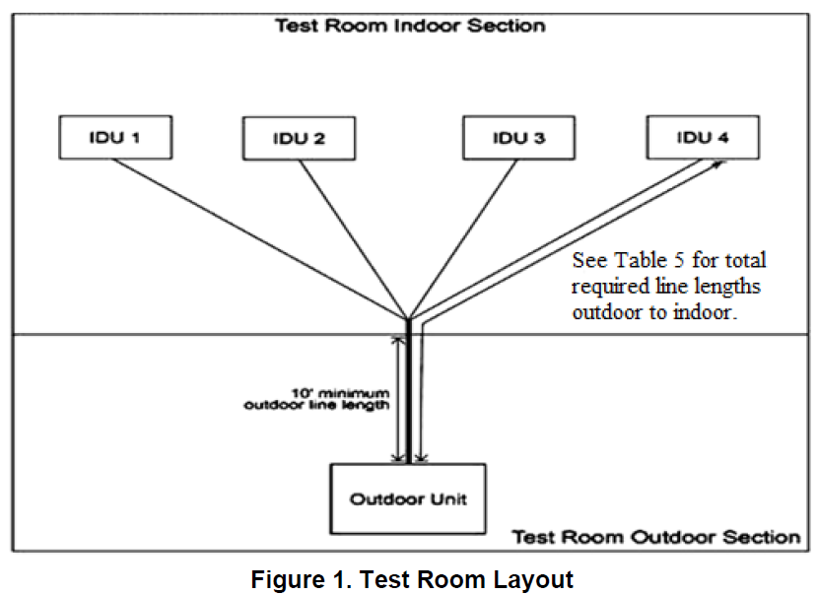
AHRI 1230-2023
Setting Critical Parameters for IEER Test Points
Section 5.1.2.1 of AHRI 1230-2023
“At each load point, Critical Parameters shall be set to the values in the Supplemental Testing Instructions. Once set, Control Settings shall remain unchanged for the remainder of test (except for allowable adjustment of Critical Parameters …”

Slide 16
Overview of AHRI 1230-2023 Controls Verification Procedure
Controls Verification Procedure (CVP): Ensures compressor speed(s), outdoor fan speed(s), and outdoor valve position(s) during steady-state testing align with native controls.
During Controls Verification Procedure (CVP):
  Native controls of VRF system control the critical parameters.
  Dry-bulb indoor temperature starts elevated and then is steadily ramped down. In response, VRF system (under native controls) starts near rated capacity, and then ramps down to part-load capacities.
  As VRF system ramps down, a budget/points system evaluates the agreement of critical parameters under native controls and those used for steady-state testing.

Slide 17
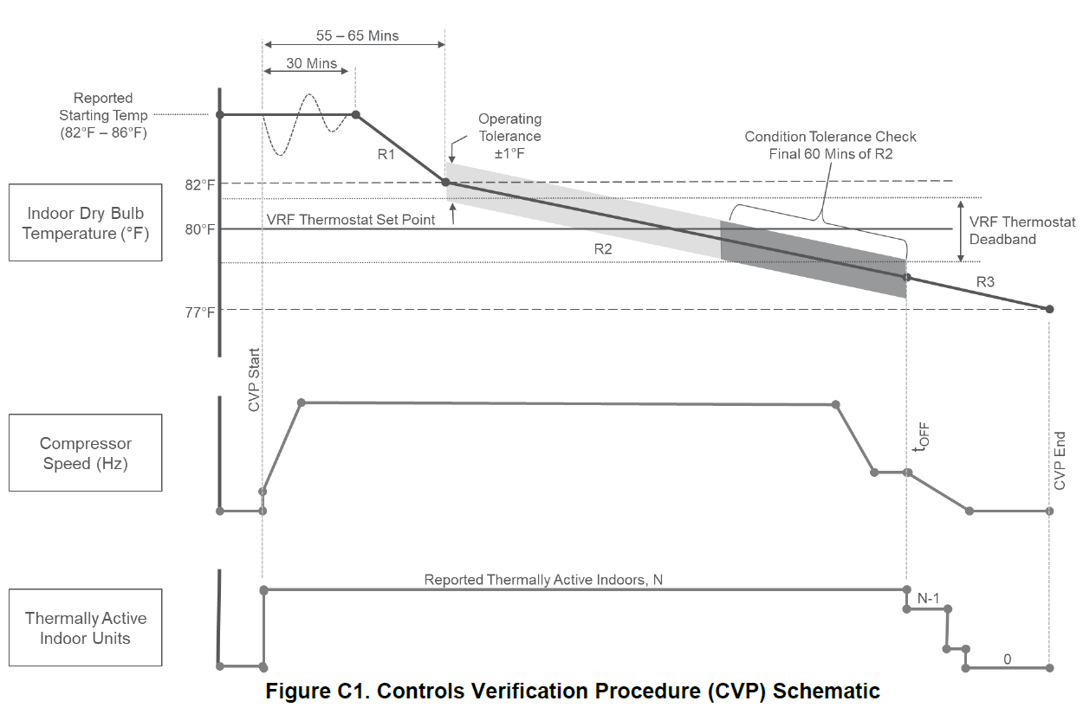
Schematic of Controls Verification Procedure (CVP)
Indoor Dry Bulb Temperature (°F)
Compressor
Speed (Hz)
Thermally Active Indoor Units

Slide 18
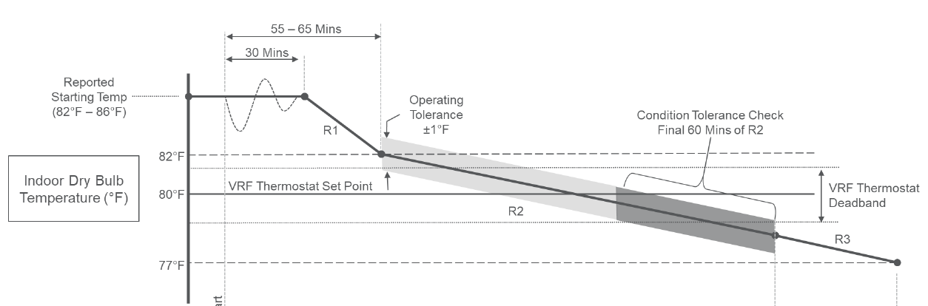
Indoor Dry Bulb Temperature
Controls Verification Procedure (CVP)
Indoor Dry Bulb Temperature (°F)
CVP Start
CVP End
T-off

Slide 19
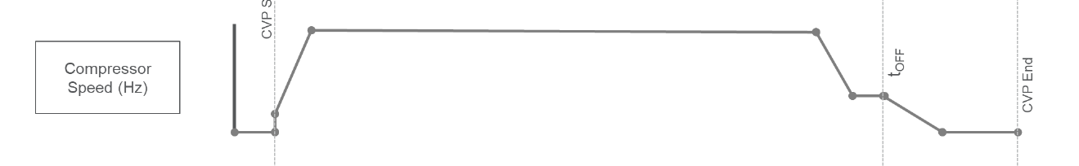
Compressor Speed
Controls Verification Procedure (CVP)
CVP Start
T-off
CVP End
Compressor
Speed (Hz)

Slide 20
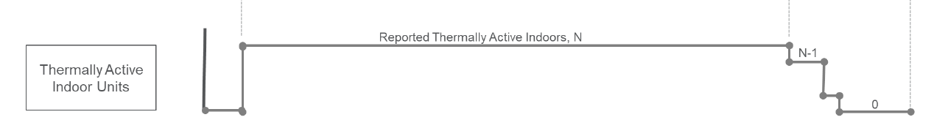
Thermally Active Units
Controls Verification Procedure (CVP)
CVP Start
T-off
CVP End
Reported Thermally Active Indoor Unit, N
Thermally Active Indoor Units

Slide 21
Controls Verification Procedure
R2 Period and Calculating Critical Parameter Variation
R2 Period Definition: “From the time that the measured indoor room dry bulb temperature first crosses from greater than 82F to less than 82F … The R2 period ends at the time when any Indoor Unit that is designated Thermally Active at the start of the CVP goes Thermally Inactive (t-off).”
Calculating Critical Parameter Variation during R2 Period:
  At each data collection interval during the R2 period, determine percent difference between each measured Critical Parameter value and the Critical Parameter value used for IEER testing.
  During R2 period, calculate the RSS Points Total using specified equations.
  Critical Parameters (used for IEER testing) are valid if average RSS Points Total is less than or equal to 70 points over specified time period.

Slide 22


Calculating Critical Parameter Variation
Controls Verification Procedure
Step 1: Critical Parameter Percent Difference
Step 2: Nominal Points Adjustment
Critical Parameter | Nominal Point Value
Compressor Speed(s) | 13
Outdoor Fan Speed(s) | 7
Outdoor Variable Value Position(s) | 1
Step 3: RSS Points Calculation

Slide 23
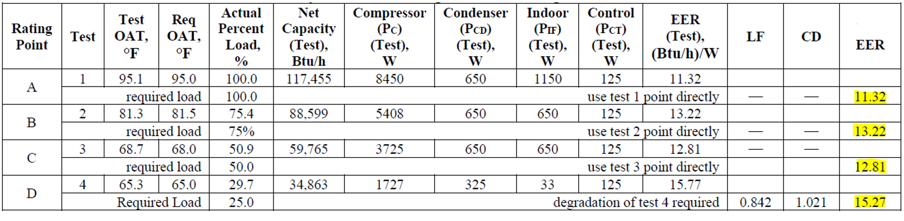

AHRI 1230-2023 Examples of IEER Calculations
Appendix G – Example 1

Slide 24
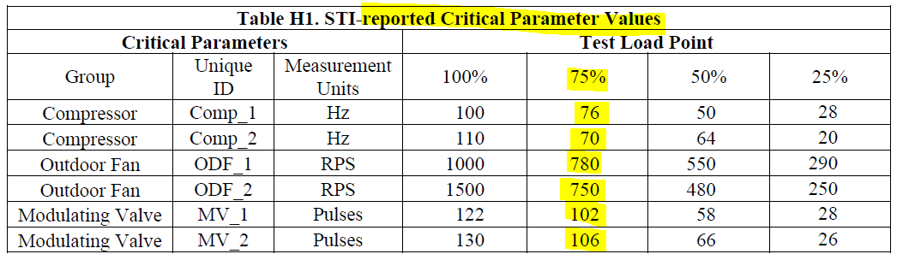
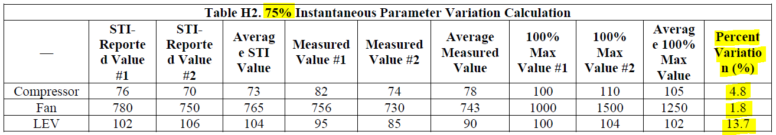
AHRI 1230-2023 Examples of CVP Calculations
Appendix H – Example 1

Slide 25
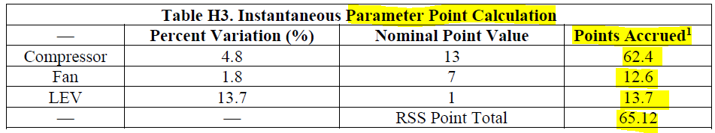
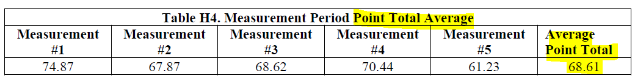
AHRI 1230-2023 Examples of CVP Calculations
Appendix H – Example 1 continued

Slide 26
What’s the Significance of AHRI 1230-2023?
AHRI 1230-2023 became effective for AHRI VRF Certification Program on January 1st, 2024.
Compared to AHRI 1230-2014 with Addendum 1 (previous test procedure for AHRI VRF program), there are major revisions for determining IEER and EER for a VRF system.
AHRI 1230-2023 is more stringent than the previous VRF test procedure.
AHRI 1230-2023
AHRI 1230-2014 (with Addendum 1)
IEER, EER
IEER, EER
≠

Slide 27
What’s the Significance of AHRI 1230-2023?
Major Test Procedure Revisions from Prior Standard
 | AHRI 1230-2014 (with Addendum 1) | AHRI 1230-2023
Sensible Heat Ratio (SHR) Limits | None | SHR Limit at 100% Full-load test SHR Limit at 75% Part-load test
Controls Verification Procedure (CVP) | None | Ensures compressor speed(s), outdoor fan speed(s), and outdoor valve position(s) during testing align with native controls.

Slide 28
Thank you for attending

