Slide 1
Supporting Healthy Buildings through Humidity Control
AHRI Humidifiers Educational Working Group

Slide 2
Humidifiers Educational Working Group
^{January 23, 2024}

Slide 3
Course
Description
With ASHRAE Standard 241 drawing increased focus towards infectious aerosol controls, healthy indoor environments are a major topic. In addition to ventilation and filtration, humidity control is an important component of healthy indoor environments.
Both recent and historical research have demonstrated links between humidity control and the health of building occupants, as well as control of infectious aerosols.
This session will explore the links between humidity and health in the school, workplace, and at home, and provide some practical approaches for achieving optimal humidity levels. Topics covered are of interest for building design professionals, professionals involved in building retrofits, building owners, facility managers, and anyone interested in healthy indoor environments.

Slide 4
Learning
Objectives
At the end of the course, participants will understand the fundamentals of:
Humidity effects on the body
Humidity effects on viral transmission
Commercial technologies for controlling humidity
Residential technologies for controlling humidity

Slide 5



Agenda and Speakers
1. Humidity, Health, and You
Michael E Dovich
Humidification Business Development Manager
Armstrong International
2. Commercial Humidity Control
David Baird
Senior Applications Engineer
Dristeem Corporation
3. Humidity At Home
Mathieu Bertrand
OEM Account Manager
Condair Ltd.

Slide 6
Section 1:
Humidity, Health, and You
Physical Principles, Causes of Dryness, Process and Occupant Effects

Slide 7
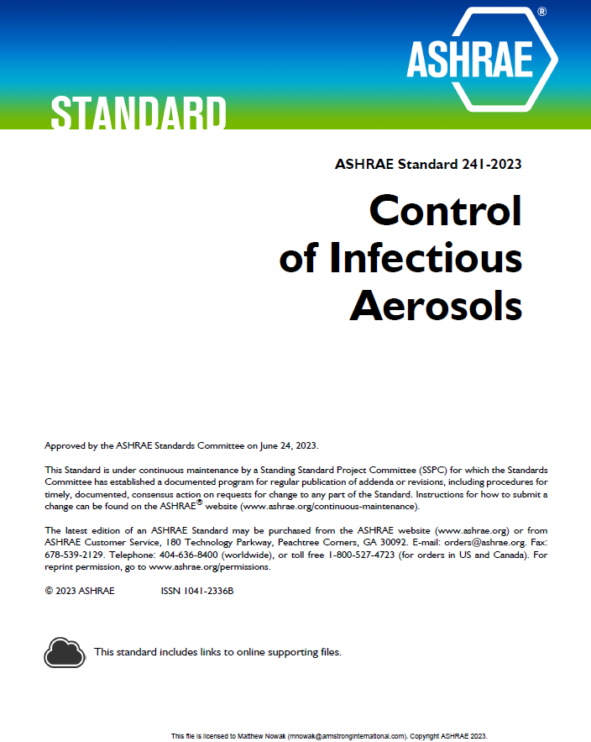
ASHRAE Standard 241
Control of Infectious Aerosols
Approved on June 24th, 2023
Ventilation and Filtration Focused

Slide 8

How Does Humidity Affect People?
Human Body Response:
  Human body is ~60% water
  Body doesn’t sense moisture well
Ambient Air Humidity Affects the Body:
  Eyes
  Skin
  Throat
  Nose
  Immune System
  Body Hydration

Slide 9

Human Body: Eyes
Our Eyes
  Protected by thin tear film
  Dry air causes increased desiccation
  Compounded by computer use
  Discomfort increases with time if dew point is below 26°F ^{[1]}
Typical Symptoms:
  Eye discomfort
  Redness
  Photosensitivity
  ¹ J.E. Laviana, F.H. Rohles, Jr. and P.E. Bullock, Humidity Comfort and Contact Lenses (ASHRAE, 1988) 94(1), 3-11.

Slide 10

Human Body: Skin
Our Skin
  Skin provides protection and thermal regulation
  Thermal regulation via evaporative cooling
  Dry environments disrupt moisture balance
  Increased evaporation rates
  Below 30% RH skin becomes dry ^{[1]}
Typical Symptoms:
  Thermal discomfort
  Dryness of skin surface
  Inflammation / aggravation of skin conditions
1 Sunwoo Y, Physiological and Subjective Responses to Low Relative Humidity in Young and Elderly Men, (J Physio Anthropol, 2006 May), 25(3):229-38

Slide 11

Human Body: Throat
Our Throat
  Provides channel for air to enter lungs
  Conditions air we breathe
  Dry air draws requires more moisture
Typical Symptoms:
  Increased need to swallow
  Vocal chord irritation^{[1]}
  US National Institute of Health recommends >30% RH and drinking water often
  ¹ National Institute on Deafness and Other Communication Disorders, Taking Care of Your Voice, https://www.nidcd.nih.gov/health/taking-care-your-voice (December 14, 2016)

Slide 12

Human Body: Hydration
Our Body and Brain
  Rely on water for many processes
  Brain is ~85% water
  Dry environments increase water loss
Possible Symptoms
  Decreased cognitive function at 2% dehydrated
  Reduced short term memory
  Increased fatigue and moodiness
Dehydration affects brain structure and function in healthy adolescents. National Center for Biotechnology Information, U.S. National Library of Medicine, 2011.
Kempton MJ, Ettinger U, Foster R, Williams SC, Calvert GA, Hampshire A, Zelaya FO, O'Gorman RL, McMorris T, Owen AM, Smith MS.

Slide 13
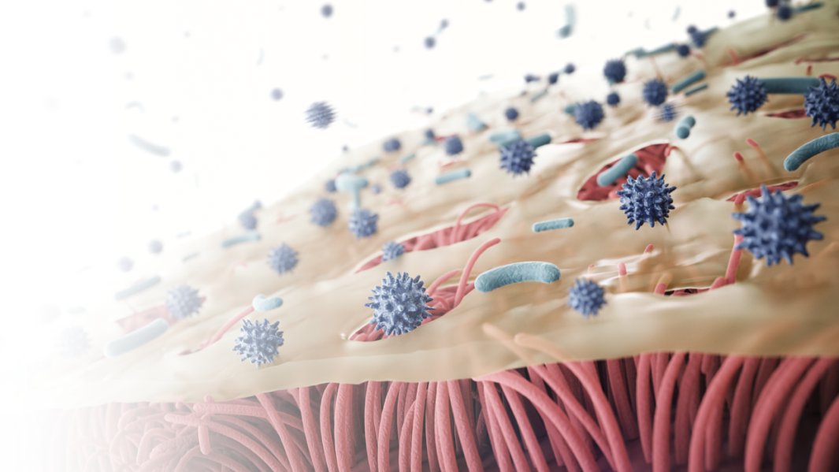
Human Body: Nose / Immune System
Our Nose / Immune System
  Mucous membrane and cilia filter we breathe
  Capture and drain infectious particles
  Dry environments desiccate and thicken mucous^{[1]}
Typical Symptoms:
  Reduced cilia motion
  Reduced ability for mucous to drain
  Increased risk of infection
¹ J.P. Guggenbichler, R. Huster and S. Geiger, Luftfeuchtigkeit und Immunabwehr
Die Rolle der Schleimhaut und Auswirkungen auf die Klimatechnik (2007) Tab Technik AM, Vol. 38, No. 9

Slide 14
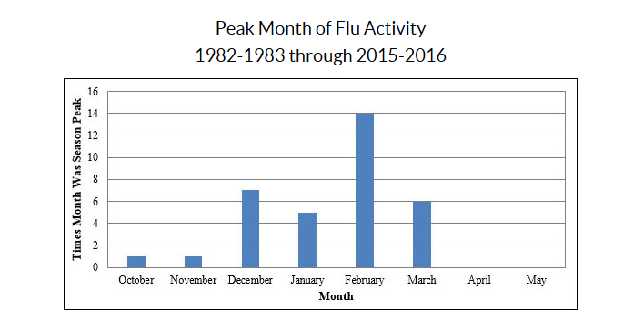
Humidity and Influenza Seasonality
Influenza Peaks During Cold Months. Why? ^{[1]}
  More time indoors in proximity to others
  Drying of nasal mucous membrane weakens respiratory system
  Influenza virus is most stable at lower RH^{[2]}
  Exhaled aerosols float longer in lower humidity
https://www.cdc.gov/flu/about/season/flu-season.htm
¹ Anice Lowen, et al, Influenza Virus Transmission Is Dependent on Relative Humidity and Temperature (October 19, 2007)
²J. Metz, et al, Influenza and Humidity – Why a bit more damp may be good for you! (June 2015)

Slide 15
Humidity and Exhaled Aerosols
Infectious payloads travel farther
  Particles lose mass quickly in dry environment
  Smaller, lighter particles travel farther
  Infectivity is retained^{[1]}
Travel Distance
1m
10+m
Droplet Size
100μm
50μm
<5μm
[1] Noti JD et. al, High Humidity Leads to Loss of Infections Influenza Virus from Simulated Coughs, PLoS ONE 8(2): e57485, 2013

Slide 16
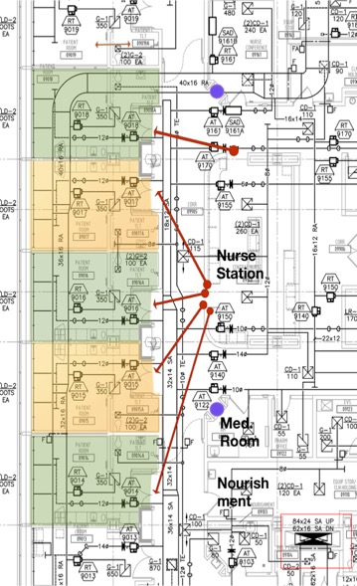
Humidity and Healthcare Infections
Room Environment vs. Patient Infection Rates Research
  Microbiome study in a new hospital in the USA
  240 single-occupancy inpatient rooms
  52 ICU beds. 28 operating suites
  A three-layer study over 13 months
  10 monitored patient rooms
  9 continuously measured parameters
  (Room ACH, visitor traffic, outdoor air fractions, room pressure, temperature,
  absolute humidity, relative humidity, CO2, air pressure, lux)
Results: 15% of Patients contracted a Healthcare Acquired Infection
Image Courtesy: Stephanie Taylor

Slide 17
Humidity and Healthcare Infections
Indoor
Relative Humidity
Healthcare-Associated
Infections
As relative humidity decreased infection rates increased
Confidence: (t < 0.02)

Slide 18

Humidity and Schools: Research
Hypothesis: “…raising absolute humidity above seasonal lows would impact influenza virus survival and transmission in a key source of influenza virus distribution, a community school.”
  Research builds upon NIOSH/CDC and microbiome research
  Focused on preschool classrooms
  Air and toys were sampled for influenza A
  Compared existing rooms with rooms where humidity was added
Office 365 Stock Images
[1] J. Reiman et al, Humidity as a non-pharmaceutical intervention for influenza A
https://journals.plos.org/plosone/article?id=10.1371/journal.pone.0204337

Slide 19
Humidity and Schools: Research
Results:
  “There were 2.3 times as many ILI [influenza like illness] cases in the control rooms compared to the humidified rooms…”
  “… whether there is a causal relationship, and its direction between the number of cases and levels of influenza virus in the rooms is not known.”
  “Additional research is required, but this is the first prospective study suggesting that exogenous humidification could serve as a scalable NPI [non-pharmaceutical intervention] for influenza or other viral outbreaks.”
[1] J. Reiman et al, Humidity as a non-pharmaceutical intervention for influenza A
https://journals.plos.org/plosone/article?id=10.1371/journal.pone.0204337

Slide 20
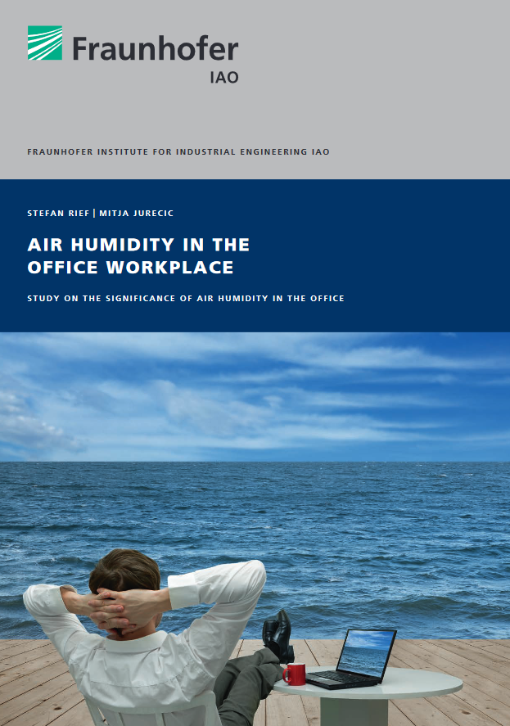
Humidity and Offices: Research
“Air humidity at the workplace can thus be assessed as a building block for increasing a person's well-being and for possibly reducing health risks.” ^{[1]}
  Reduced eye strain
  Reduced vocal strain
  Reduced allergy and asthma impact
  Increased employee performance
  Mental acuity
  Improved perceived comfort (“humidex”)
^{[1]} Rief S and Juric M, Air Humidity in the Office Workplace, Fraunhofer IAO, 2014

Slide 21
Summary: Optimal Humidity for Health
For Occupant Health:
40 – 60% RH
©ASHRAE, www.ashrae.org. 2016 ASHRAE Handbook: HVAC Systems & Equipment, Ch 22.1
Adapted from Sterling et al. 1985

Slide 22
Section 2:
Commercial Humidity Control
Solutions for Commercial Applications

Slide 23
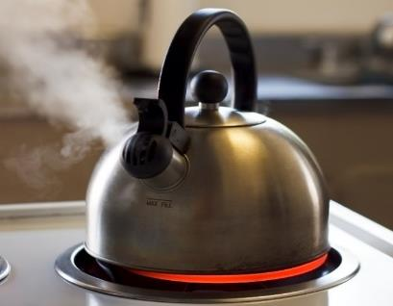
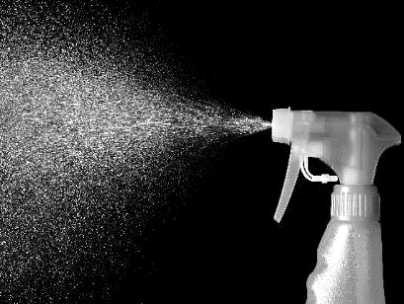
Methods for Adding Moisture to Air
Steam
  Water is boiled and steam is introduced into the air
  Energy for phase change comes from electricity, gas, boiler steam, or high temperature hot water
  Air temperature remains similar
Spray / Evaporative
  Liquid water is introduced directly into the air by spraying or through a wetted media
  Energy for phase change from ambient air
  Air temperature decreases (“evaporative cooling”)

Slide 24
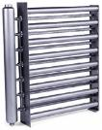
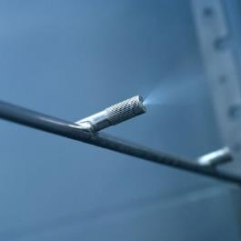
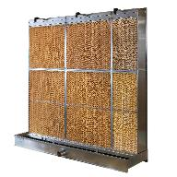
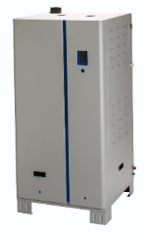
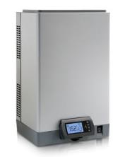
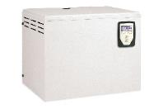
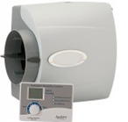
Fundamental Types of Humidifiers
Isothermal: Steam Systems | Adiabatic: Atomizing / Evaporative Systems
Introduces steam to air Ideal for small – medium loads Air heat gain from distributors Require primary energy source Often “Packaged” | Introduces water to air Ideal for medium – large loads Cooling effect May require air preheating Often “Engineered”
Images: Courtesy AHRI Member Companies

Slide 25
Steam Humidification Technologies

Slide 26
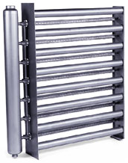
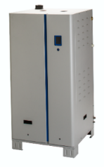
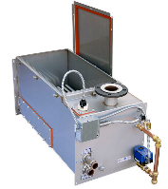
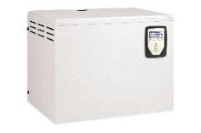
Commercial Steam Humidifiers
 | Facility Steam Direct | Electric Electrode | Electric Resistive | Gas-Fired | Facility Steam Exchange
Energy | Boiler Steam | Electricity | Electricity | Natural Gas Propane | Boiler Steam
Water Type | - | Potable | Potable, RO, DI | Potable, RO, DI | Potable, RO, DI
Capacity | 2 – 3300 lb/h 1 – 1500 kg/h | 5 – 300 lb/h 2 – 90 kg/h | 5 – 300 lb/h 2 – 90 kg/h | 50 – 650 lb/h 23 – 300 kg/h | 50 – 1200 lb/h 23 – 550 kg/h
Capital Cost | $ | $$ | $$ | $$$ | $$$
Operating Cost | $ | $$$ | $$$ | $ | $$
Key Advantage | Low costs | Ease of maintenance | High accuracy | Low operation cost | Clean steam
Images: Courtesy AHRI Member Companies

Slide 27
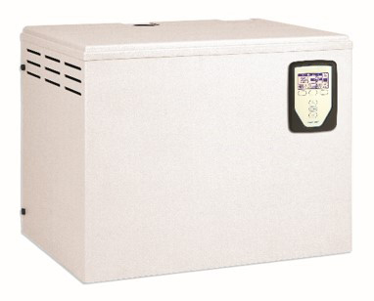
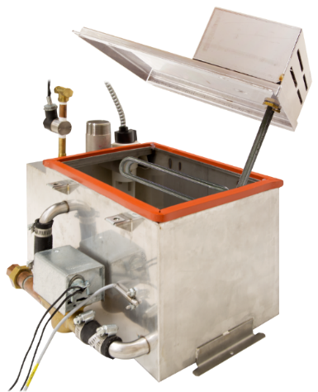
Resistive Element Humidifiers
Application Considerations
  Small to large humidification needs
  Precision control
Advantages
  Simple equipment design
  Wide range of voltage options
  Suitable for potable, RO, DI water
Immersed heating elements boil water generating steam

Slide 28
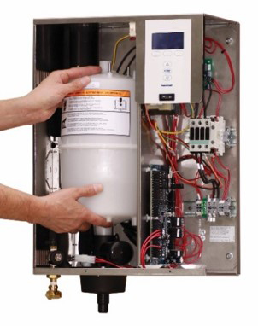
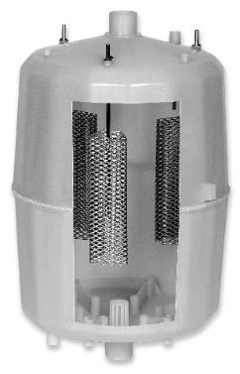
Electrode Steam Humidifiers
Application Considerations
  Doesn’t require high level of control (+/- 5%)
  Minimal on-site maintenance expertise
  Potable water (conductivity 150 – 1500 μS)
Advantages
  Easiest maintenance (replace canister)
  Low first cost
  Electricity passes between submerged electrodes, resistance of the water causes the water to boil and generate steam

Slide 29

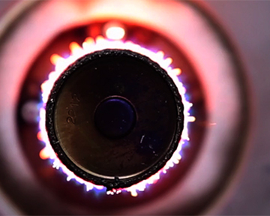
Gas-Fired Humidifiers
Application Considerations
  Small to Large Loads
  Natural or propane gas available
  Ability to vent flue gases to outside
Advantages
  Low energy cost
  Larger capacities per unit than electric
  Operates on potable, RO, or DI water
  Natural gas / propane is burned in a heat exchanger to create heat for boiling the water

Slide 30
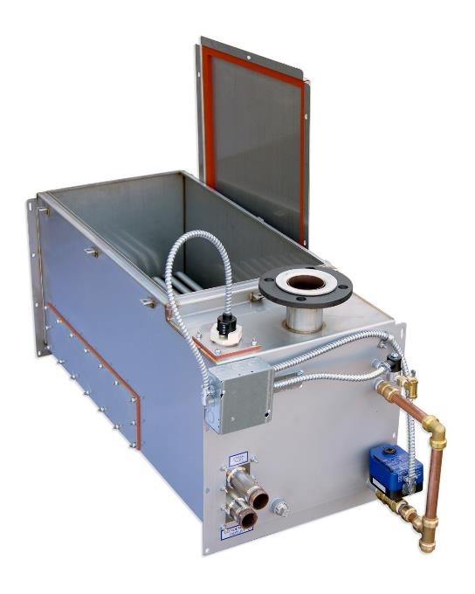
Steam to Steam Heat Exchange
Application Considerations
  Requires steam from facility boiler
  Commonly used in hospitals and schools
Advantages
  Boiler chemicals are contained and
  returned to boiler
  Clean steam for humidification
Boiler steam passes through submerged heat exchanger, providing heat to convert clean water into humidification steam

Slide 31
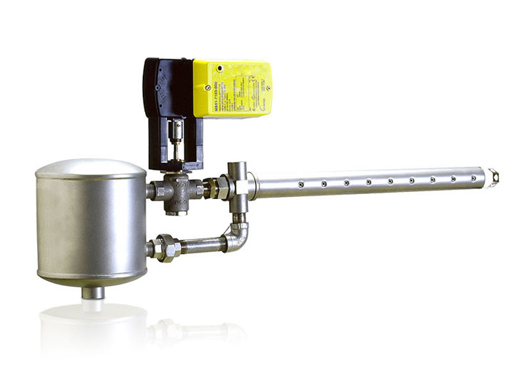
Direct Facility Steam
Application Considerations
  Central facility boiler / steam on site
  Hospitals, Schools, Campuses
  Industrial
Advantages
  Lowest first cost
  Minimal maintenance
  Uses existing on-site steam
Boiler steam passes through a steam separator, a control valve and finally through a distribution tube into the air stream

Slide 32
Steam Distribution Options

Slide 33
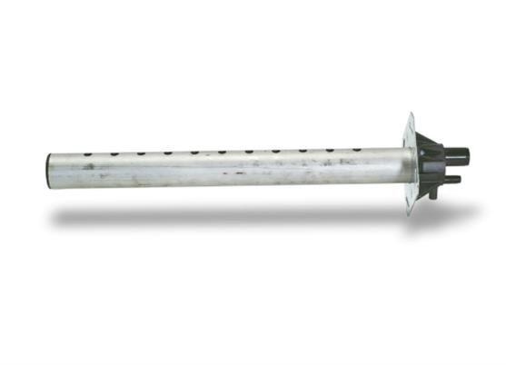
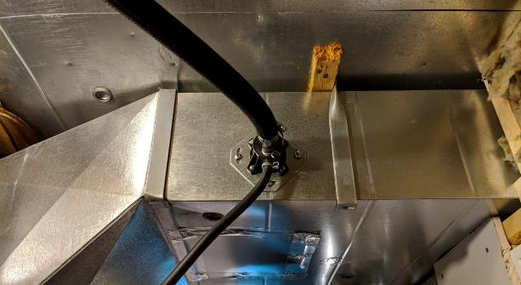
Single Tube Steam Distributors
Perforated tube design with condensate drainage
Advantages
  Low first cost
  Rapid installation
  Easy plumbing for single tube
Disadvantages
  Longer absorption distance than manifolds
  Complicated plumbing for multiple tubes

Slide 34
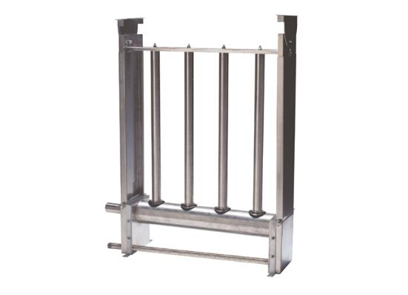
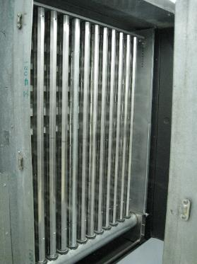
Short Absorption Distribution Grids
Multiple perforated tubes in a packaged device with condensate management
Advantages
  Short absorption distances
  Rapid installation
  Easy plumbing
Disadvantages
  Higher first cost than single tube
  Increased air heat gain / condensate

Slide 35
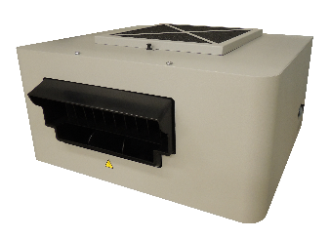
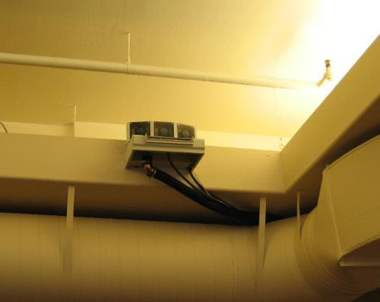
Room / Area Fan Distribution
Fan assisted steam dispersion
Advantages
  Provides humidity directly to space
  Rapid installation
  Easy plumbing
  No ductwork required
Disadvantages
  Additional power and drain often required
  Fan noise may be intrusive
  Steam requires space to absorb
  Must be safely positioned

Slide 36
Adiabatic Humidification Technologies

Slide 37
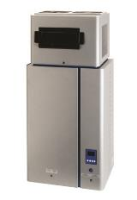
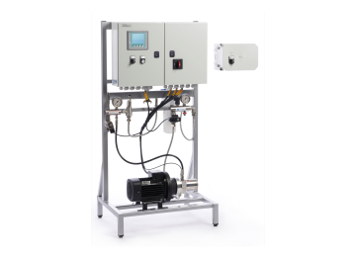
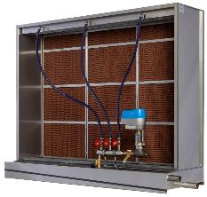
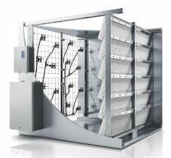
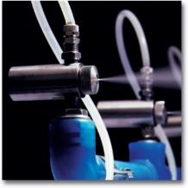
Commercial Adiabatic Humidifiers
 | Ultrasonic | Compressed Air Fogging | High-Pressure Fogging | Evaporative Media | Hybrid Fogging
Energy | Electricity | Compressed Air | Electricity | Electricity | Electricity
Water Type | RO, DI | Potable, RO, DI | RO, DI | Potable, RO | RO, DI
Capacity | 5 – 50 lb/h 2 – 23 kg/h | 5 – 1000+ lb/h 2 – 450+ kg/h | 200 – 3000+ lb/h 90 – 1300+ kg/h | 50 – 2000+ lb/h 22 – 900+ kg/h | 50 – 2000+ lb/h 23 – 900+ kg/h
Capital Cost | $$ | $ | $$ | $$$ | $$$
Operating Cost | $$ | $ | $$ | $ - $$$ | $$
Key Advantage | Packaged Product | Low costs | Largest capacities | Highest Cooling Performance | Compact Footprint
Images: Courtesy AHRI Member Companies

Slide 38
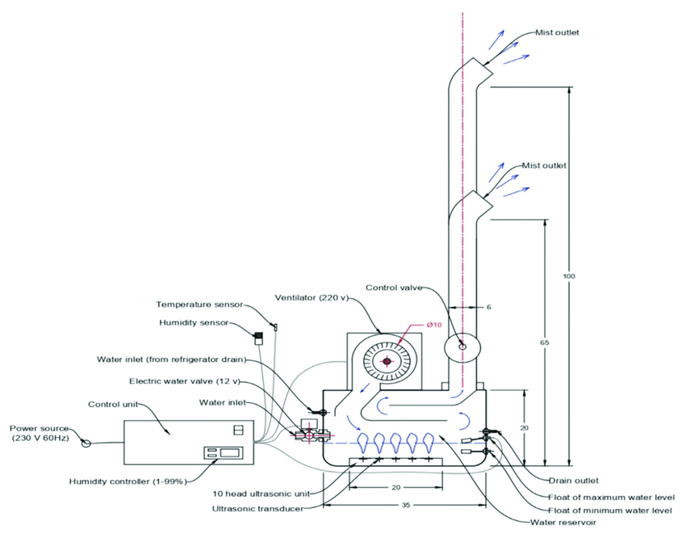
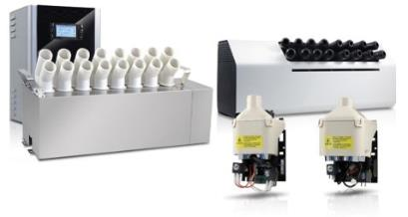
Ultrasonic Humidifiers
Applications
  Small to medium humidification
  Direct room or ducted models
Advantages
  Near silent operation
  Packaged product – easy to install
  Instant output / shutoff
Considerations
  Treated water and maintenance required to prevent dust and biological concerns
Piezoelectric disks vibrate at high frequency causing water molecules to fly apart into the air steam

Slide 39
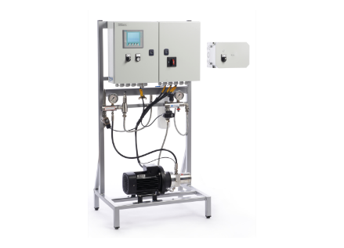
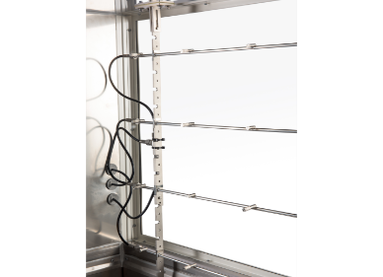
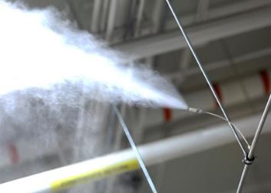
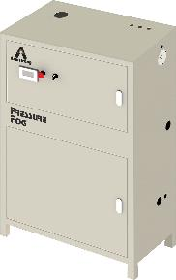
High Pressure Atomization
Applications
  Broadly applicable, many applications
  Direct room or ducted models
Advantages
  Scalable performance for large loads
  High-reliability, low maintenance
  Instant output / shutoff
  Higher accuracy than wetted media
Considerations
  Usually customized for application
  Treated water required
  Pump, Valves, Nozzles
  Staged control
Pressurized water (~1000 psi) is sprayed through small orifice nozzles to create a very fine mist

Slide 40
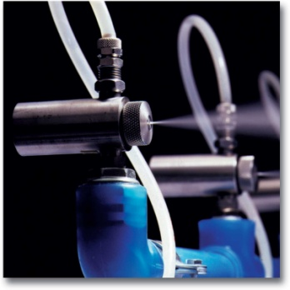
Compressed Air Fogging
Applications
  Industrial, manufacturing
  Direct room or ducted models
Advantages
  Scalable performance for large loads
  High-reliability, low maintenance
  Instant output / shutoff
Considerations
  Usually customized for application
  Treated water may be required
  Louder nozzles than high-pressure
  Air compression cost
Compressed air mixes with water in the nozzle to shear droplets into a very fine mist

Slide 41
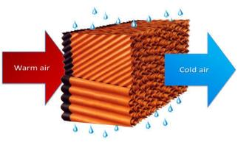
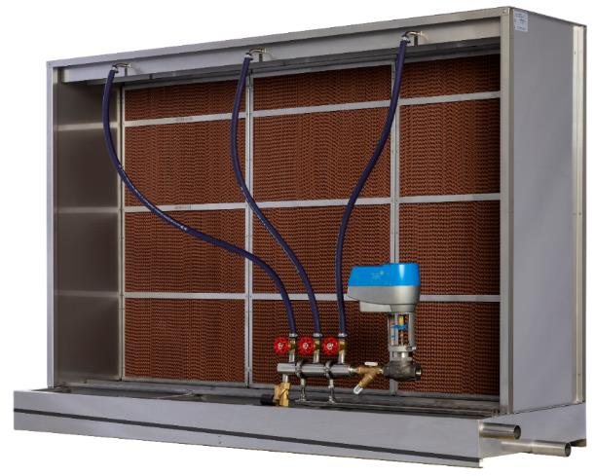
Wetted / Evaporative Media
Applications
  Data Center Cooling
  General humidification/cooling
Advantages
  Scalable performance for large loads
  Highest cooling performance
  Works with Potable/Softened/RO water
  Low-cost operation
  No evaporation distance
Considerations
  Media is consumable
  Slower response times/accuracy
  Hygiene and water quality
  Not suitable for healthcare
  Air pressure drop across media
Water is pumped over a specialized filter media. Air passing through the media evaporates water.

Slide 42
Hybrid Fogging
Applications
  General humidification/cooling
  Airports, Auditoriums, Large Facilities
Advantages
  Scalable performance for large loads
  Smaller footprint than fogging alone
  Low-cost operation
Considerations
  Treated water (RO/DI) required
  Wet section with drain required
Water is sprayed onto a specialized filter media. Air evaporates both the fog and droplets in the media.
Water is sprayed onto a specialized filter media. Air evaporates both the fog and droplets in the media.

Slide 43
Direct Room Applications
Humidifier / Distributor in Space
Advantages:
  Fast response and improved accuracy
  Only humidifies area requiring moisture
  More, smaller systems reduces failure risk
  Suitable for nearly all loads
Challenges
  Some technologies generate noise
  Consider evaporation distance (avoid wetting)
  Ceiling mounted systems need maintenance access
  Consider future leaks/drips when placing nozzles around equipment

Slide 44
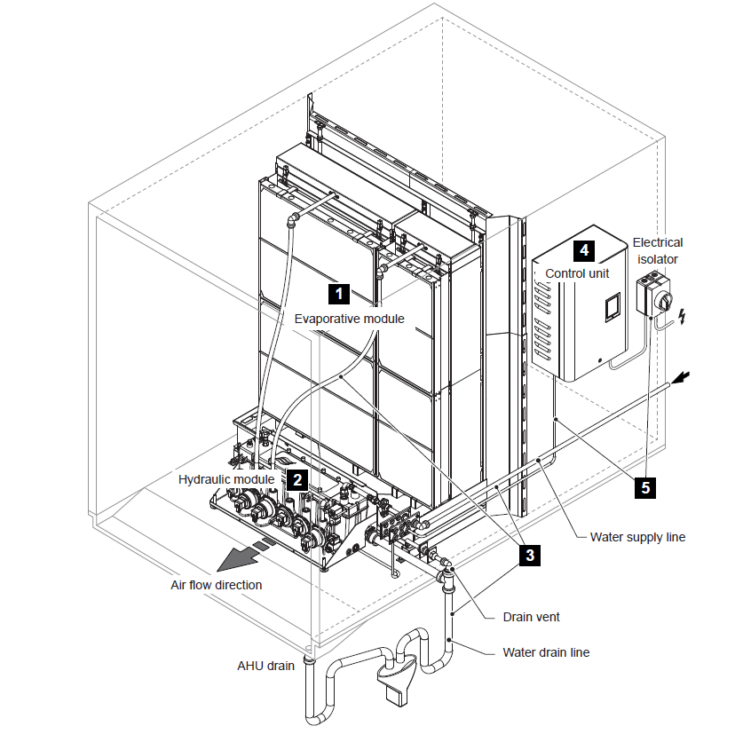
Ducted Applications
Humidifier / Distributor in Duct
Advantages:
  Central ventilation distributes moisture
  Humidifier located in mechanical room
  No visible spray or nozzle noise
  Suitable for all capacity sizes
Challenges
  Requires mechanical room space
  Need adequate space in AHU / ductwork
  Need to consider wet section / drains
  Droplet filters may be required
  Pressure drop across certain systems increases as minerals accumulate
Image courtesy: AHRI Member Company

Slide 45
Section 3: Humidity At Home
Residential Applications

Slide 46

Spending More Time at Home
Hybrid WFH / office flex here to stay
Increased IAQ awareness
Investment by homeowners to improve IAQ
Increased viral susceptibility post pandemic

Slide 47
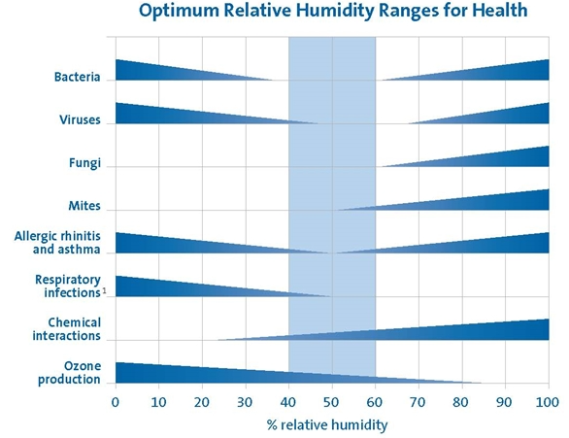
Residential Humidity
Maintaining a relative humidity of 40-60% is critical for human health.
  Minimizes the presence and transmission of airborne viruses, bacteria, allergens and other unhealthy particles.
  Protects the respiratory tract and quality of sleep.
  During the cold dry winter months, it is commons for eyes, lips and hands to dry out and become irritating.
Preserves valuable assets
  Hardwood flooring and furniture
  Artwork
  Musical instruments.

Slide 48







Healthy Indoor Environments
It’s time to rethink healthy indoor environments
  WE
  THOUGHT
keeping buildings dry is a
strategy for eliminating
microbes and preventing
health problems
WE KNOW
Dampness creates conditions favorable to mold
low RH intermediate RH high RH

Slide 49


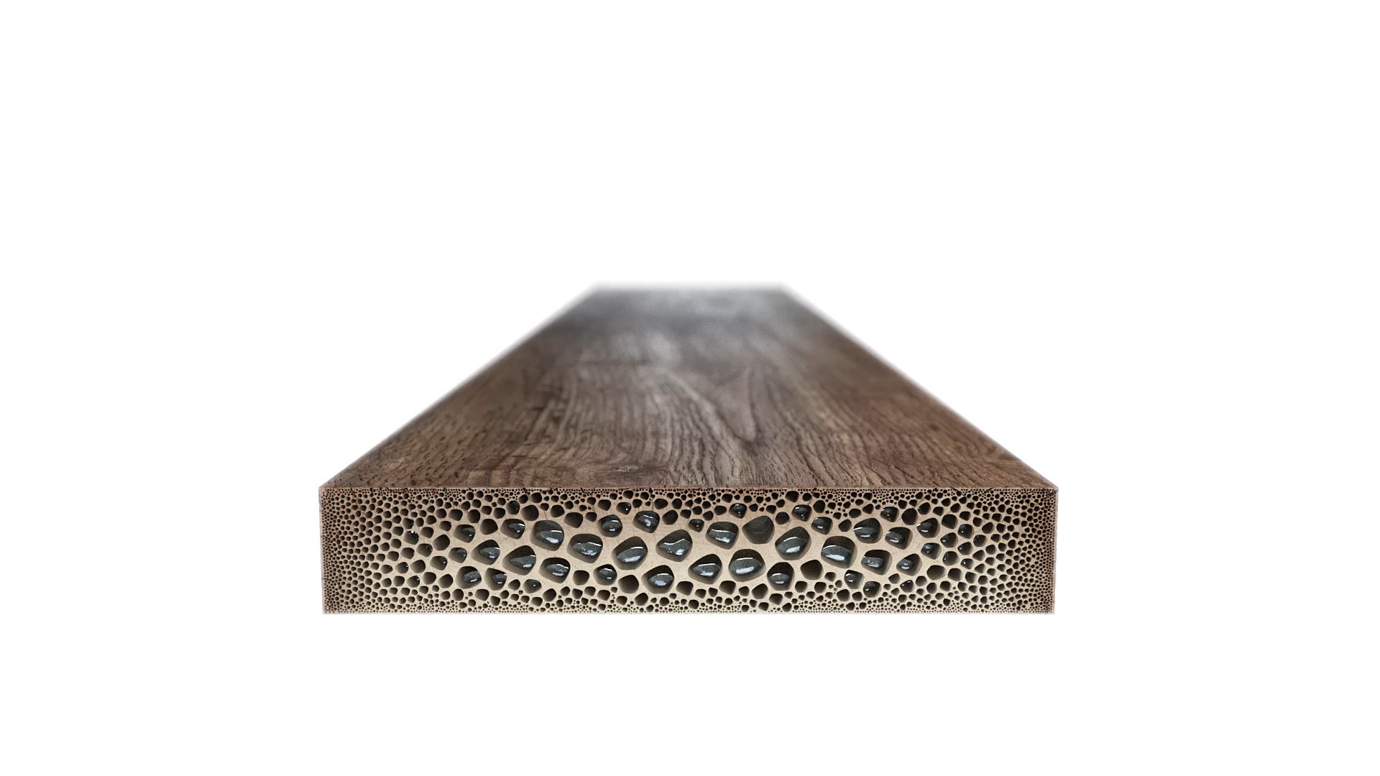

Humidity and the Home Itself
Hygroscopic materials
  Hardwood
  Building Finishes
  Acoustic Instruments
  High Value Artwork
Quality concerns:
  Dimensional instability
  Cracking / deterioration
  Coating delamination

Slide 50


Homes During the Heating Season
Sensible Heating
Outside Air (Chicago)
4°F (-15°C)
61% RH
4 gr/lb (0.6 g/kg)
Inside Air
70°F (21°C)
4% RH
4 gr/lb (0.6 g/kg)
Ventilation
In/Exfiltration
Heating outside air with low absolute humidity dries the building.
Image: Free Stock Photos 14413

Slide 51
How Much Humidity?
Example:
3,500 ft² | 8 ft. Ceilings | 28,000 ft³ | 2,074 lbs. of air
To get to 50% RH, you need to 56 gr/lb of air.
2,074 lbs x 56 gr/lb = 116,144 grains
116,1444 gr / 56,000 gr/gallon = 2.074 Gallons
½ ACH = 1.037 Gallons per hour
1.037 Gallons/Hour x 24 Hours = 24.9 GPD
Inside Air
70°F (21°C)
4% RH
4 gr/lb (0.6 g/kg)
Image: Free Stock Photos 14413

Slide 52
Sizing Guideline
Structure Tightness | 1,000 ft² | 1,500 ft² | 2,000 ft² | 2,500 ft² | 3,000 ft² | 3,500 ft² | 4,000 ft²
Tight | 4.3 GPD | 6.4 GPD | 8.5 GPD | 10.6 GPD | 12.7 GPD | 14.8 GPD | 16.9 GPD
Normal | 8.6 GPD | 12.8 GPD | 17.0 GPD | 21.3 GPD | 25.4 GPD | 29.6 GPD | 33.8 GPD
Loose | 12.7 GPD | 19.1 GPD | 25.5 GPD | 31.8 GPD | 38.1 GPD | 44.4 GPD | 50.7 GPD
Assumptions:
Standard 8 ft. ceilings
Per AHRI, average family of 4 will add 2 GPD naturally.
Sweat, Breathing, Cooking, Showers, etc.

Slide 53
Residential Humidification Needs
  Blue: humidification & DH Red: humidification load all year Orange: marginal humidification & DH

Slide 54
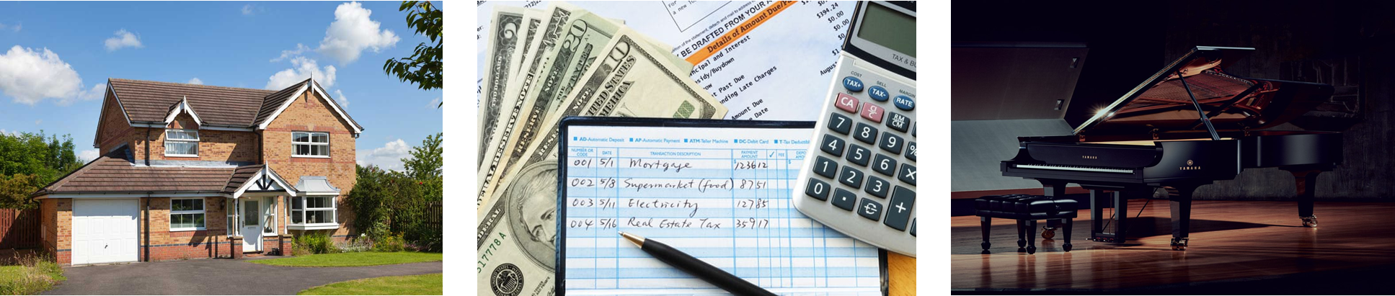
Planning for Residential Projects
Square-Footage?
Budget?
ROI on Asset Preservation?

Slide 55

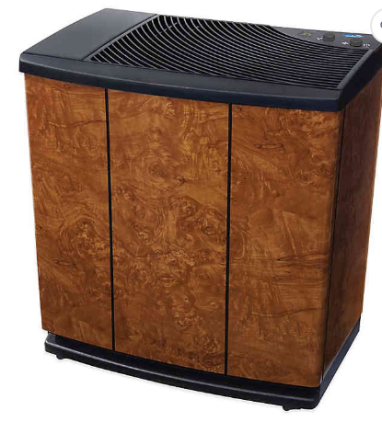
Technologies: Portable
Applications:
Spot or localized humidification
Pros:
Easy to obtain (retail)
Portable
Cons:
Limited to no controls
Misting (ultrasonic) humidifiers require DI water to avoid white dust.
Standing water
Limited capacity
Require refilling of water

Slide 56


Forced Air Applications - Evaporative
Applications:
Forced air Systems
Bypass and Power Configurations
Pros:
Whole home capacities
No standing water
Flexible installations
Manual, Automatic and Thermostat controls
Easy maintenance
Low cost installation
Cons:
Capacity effected by plenum temperatures
Requires forced air system

Slide 57



Forced Air Applications – Steam
Applications:
Forced air and non forced air systems
Large capacities available
Steam generator and dispersion units can be mounted remotely from each other
Pros:
Whole home capacities
No standing water
Flexible installations
Manual, Automatic and Thermostat controls
Easy maintenance (canister type)
Capacity not effected by plenum temperatures
Cons:
Installation cost higher than evaporator
Can require separate electrical circuit

Slide 58




Direct Room & Non-Ducted Air Applications
Non-Ducted Evaporative Humidifiers are
designed specifically for a whole-home
solution that helps you achieve total
comfort through humidity control.
While designed for homes with radiators
or baseboard heating systems, they are so effective and flexible that they work
equally well in homes with central heating and cooling systems.
Installed by a local HVAC professional.

Slide 59
Summary
Supporting Healthy Buildings Through Humidity Control

Slide 60

Summary
Learning Objectives (Review):
Humidity effects on the body
Humidity effects on viral transmission
Commercial technologies for controlling humidity
Residential technologies for controlling humidity

Slide 61
Questions?
Supporting Healthy Buildings Through Humidity Control
AHRI Humidifiers Educational Working Group

