Slide 1
What Manufacturers Can Get Out of It: The Value in Partnering with Voluntary Programs
Nicky Dunbar, NEEA
Matt Derner, Hydraulic Institute
Sal D’Auria, Ventacity Systems
January 23, 2024 – AHR Expo
Classification Level: Public

Slide 2
Summary: What’s in it for you?
Who is NEEA?
What products does NEEA work on?
What is market transformation and what's the role of voluntary programs?
What’s the difference between NEEA and utility programs?
How have we partnered with industry?
Hydraulic Institute
Ventacity
Better Bricks
How else can we partner?

Slide 3
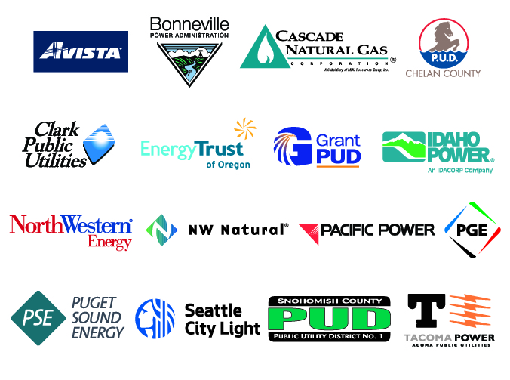
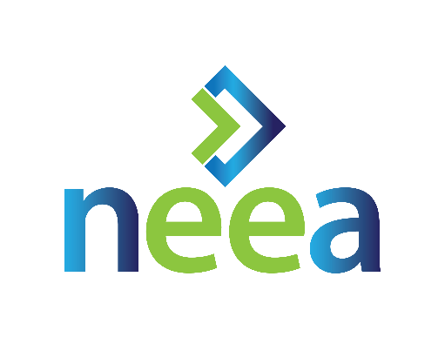
Who is NEEA?
Notes:
NEEA is a regional alliance of more than 140 Northwest utilities and energy efficiency organizations in OR, WA, ID and MT, including BPA and Energy Trust.
They have been around since 1996 and are tasked with securing energy efficiency for their alliance partners in the region. They find new EE technologies and services (either pre-market or new to mkt, in US or other countries) & are funded by their partners to work upstream (w/ installer, designers, manus, manu reps/distributers) to drive adoption of them.
Their partners represent more than 13 million energy consumers in the 4 NW states.
NEEA’s work spans both the commercial and residential sectors, and they provide numerous resources about energy efficient technologies including HVAC, lighting, pumps, windows and more across a variety of building types. They do this through their BetterBricks platform.
Whether you design, build, manage, sell or operate commercial buildings, BetterBricks provides plenty of resources and tools to incorporate energy efficient technologies and their many benefits, into buildings.

Slide 4
What products does NEEA work on?
PRODUCTS
INTEGRATED SYSTEMS
NEW CONST.
HVAC
PRODUCT GROUP
HVAC
PRODUCT GROUP
HVAC
PRODUCT GROUP
HVAC
PRODUCT GROUP
Consumer Products
Motor-Driven Products
Water Heating Products
HVAC Products
Lighting Products
Building Envelope
New Construction
Retail Products Portfolio
Extended Motors Products
Heat Pump Water Heaters
High Performance HVAC
Luminaire Level Lighting Controls
Window Attachments
Commercial Code Enhancement
Super-Efficient Dryers
Efficient Gas Water Heating
(natural gas)
Ductless Heat Pumps
Manufactured Homes
OTHER / INFRASTRUCTURE
Condensing Rooftop Units
(natural gas)
Next Step Homes
(gas+electric)
Strategic Energy Management
Top-Tier Trade Ally
Distributor Platform
Notes:
Reminder: NEEA is implementing organizational changes to align with 2020-24 Business Plan (they got email in June summarizing key changes)
Primary change is shift from sector to product groups (and why)
Two new roles created (and why)
RPAC is continuing to work on refining the roles and charters of advisory committees and work groups – to both streamline and adjust for NEEA’s new org structure
Hopefully they have been talking about this with their RPAC member
Until RPAC – and the Board – finalize changes to the Advisory Committee process, we’ll continue business as usual

Slide 5
What does NEEA do?
EMERGING TECHNOLOGIES
PORTFOLIO EXECUTION
CODES
& STANDARDS
CONVENE AND COLLABORATE
MARKET INTELLIGENCE
Notes:
NEEA stimulates innovation and delivery of energy efficient technologies.
We influence entire markets by increasing the supply and demand for energy-efficiency through portfolio execution activities.
And, we work at state and national levels to influence more efficient codes and standards to lock in energy savings.
We selectively support dialogue and coordinate activities among stakeholders interested in accelerating efficiency through market transformation in the Northwest.
We conduct regional building stock assessments, market research and evaluations to gather market intelligence that informs both our programs and local utility programs.
….All of these activities can be grouped under a single banner we call ‘Market Transformation’
Alternative Notes from BP Slides:
In the next cycle, NEEA will employ 5 strategies for market transformation that create long-term markets for energy efficiency. They are:
Emerging Technology– Routinely scan for, assess, and report on the potential for new efficiency products, services, and practices and test the field performance of the most promising opportunities.
Effective Portfolio Execution – Implement the prioritized portfolio of initiatives, routinely evaluate progress, and adapt as necessary to achieve accelerated and sustained market adoption.
Codes & Standards – Influence development and support successful implementation of building codes and equipment efficiency standards and test methods to materially improve efficiency outcomes.
Convene and Collaborate – Selectively support dialogue and coordinate activities among stakeholders interested in accelerating efficiency through market transformation in the Northwest.
Market Intelligence – Research, analyze, and provide actionable insight to support identification and pursuit of efficiency opportunities and results reporting.

Slide 6
Identify barriers / opportunities
Market Transformation
Intervene to remove or leverage
The strategic process of intervening in a market to create lasting change.
Track and evaluate market progress
Notes:
To move entire markets toward more energy-efficient products, services and practices, we:
Identify barriers and opportunities (price, availability, quality, etc.).
And, we intervene to remove those barriers or leverage opportunities (through education and training, upstream incentives, buy-downs, etc.).
Overtime, we track market progress and evaluate the impact of our programs and make adjustments as necessary.

Slide 7
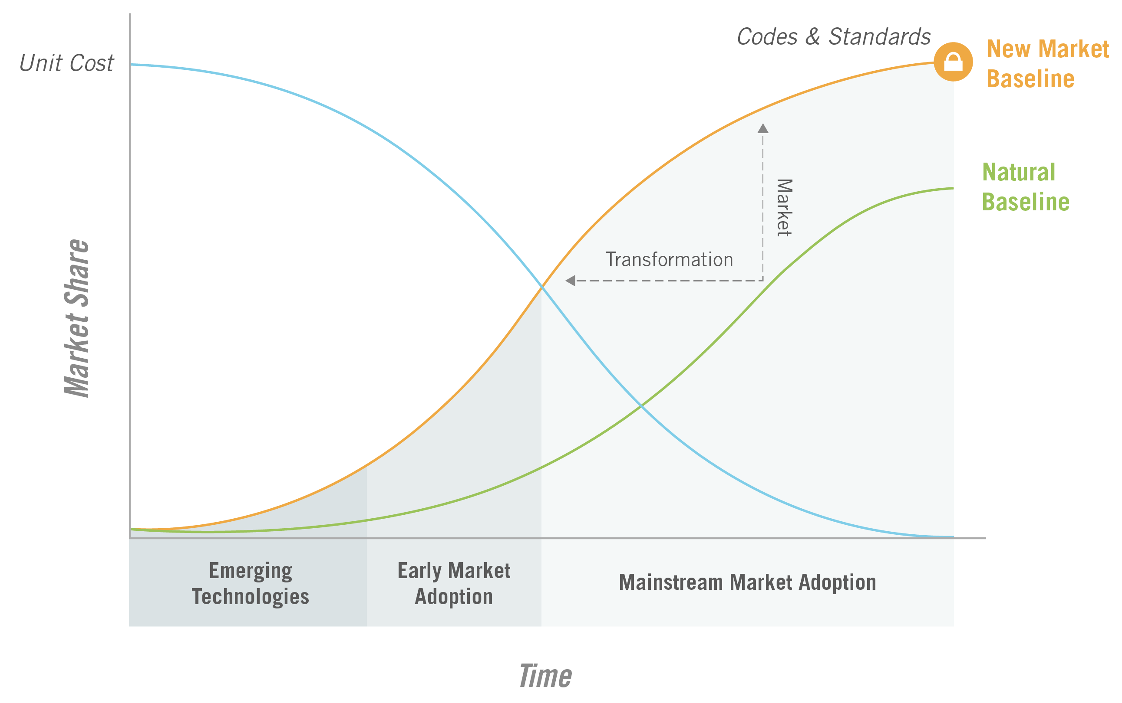
Market Transformation
Notes:
This graph shows the impact of market transformation over time on market share.
As you can see from the graph, as market share increases NEEA’s investment decreases.
In fact, the majority of savings from NEEA market transformation program come years after we’ve stopped paying for it.
The investments we make today deliver savings far into the future. As a result, our programs are extremely cost-effective.

Slide 8
Why focus on buildings? Major fuels consumption by end use (2018)
Source: U.S. Energy Information Administration, Commercial Buildings Energy Consumption Survey; Note: Btu = British Thermal Units
8
Notes:
HVAC is expensive to design, install, maintain and operate, and these systems are a significant portion of the energy costs of commercial buildings. As you can see, space heating, ventilation and cooling combined use over 40% of total building energy in commercial US buildings. It’s very important for business/building owners/operators to get HVAC right.

Slide 9
Advanced Technologies Are Available to Lower Energy Consumption
Technology | Overview
Pumps and Circulators | Pumps and circulators are the heartbeat of your building. Efficient equipment and smart controls can reduce overall energy consumption significantly.
Ventilation Air Systems | Your building needs fresh air to maintain a healthy and comfortable environment. Advanced equipment re-captures energy from exiting air, reducing heating and cooling equipment usage.
Advanced Lighting Controls | LLLC
Secondary Windows | Window Attachments
9
Notes:
Who here operates or owns buildings that have pumps in them? They are everywhere, in every building. Not necessarily our homes, but all commercial buildings. Powering
Space heating, cooling, water heating, pressure boosting all add up to +35% of energy consumption in commercial buildings. Pumps may not be the biggest consumers of these systems, but they have easy opportunities for energy and cost savings, with quick paybacks, and often these changes can improve the overall efficiency of the system (for more energy savings) and/or can increase performance of these systems, making them easier to operate and providing more comfort to occupants/tenants.

Slide 10
Who We Work With
Manufacturers
Retailers
Government
Other
Notes:
NEEA has built long-term relationships and partnerships with national and international organizations.
Our partners include some of the largest retailers, distributors and manufacturers in the World (e.g. Costco, Walmart, Samsung, etc.), as well as local market actors.

Slide 11
Isn’t NEEA just a utility program?
We are so much more!
Funded by utilities
Involved in the market much earlier
Invested in MT
Set up foundation for utilities to be able to run programs
Can engage in ways that utilities may not (long term thinking, paybacks, etc.)
Don’t engage with direct power customers

Slide 12
How do we do it?
Research
Field studies
Lab testing
Emerging Technology Partnerships
Market Partnerships
Incentives
Advocacy

Slide 13
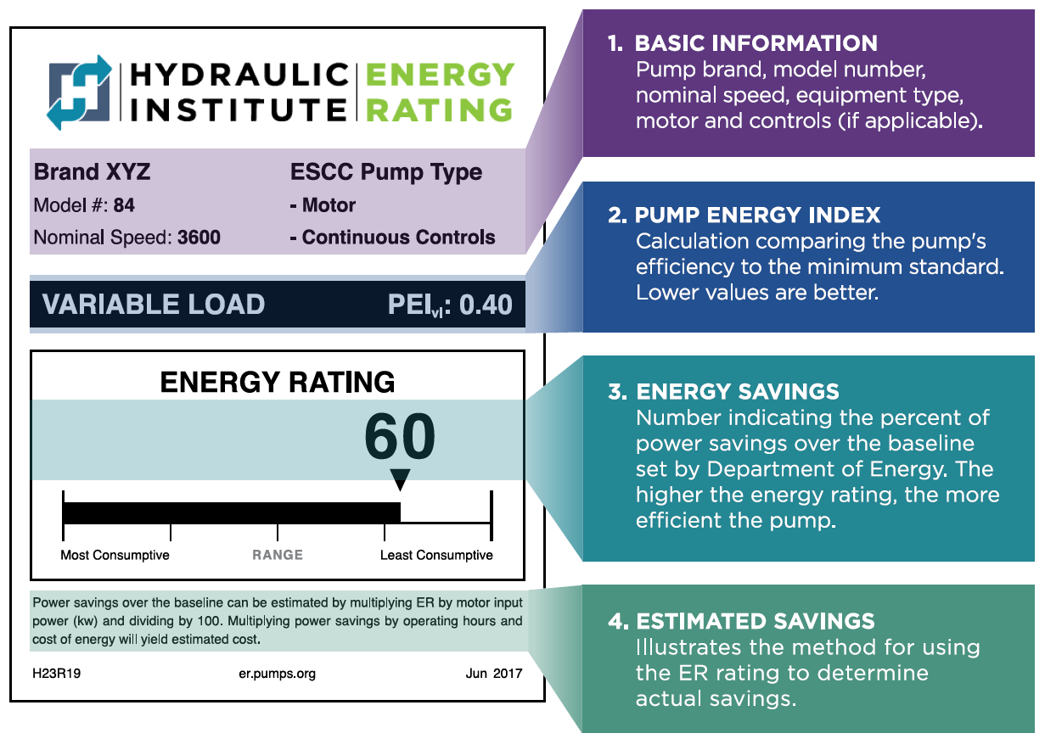
Partnering with Hydraulic Institute
ER Label = comparison tool similar to ENERGY STAR
Labels feed a database – provides info for utility QPL, NEEA program, etc.
Notes:
The label is a visible representation of the energy performance to a potential pump purchaser and can therefore move the market towards more efficient decisions that reduce costs and save energy. In many cases, the ER label will be displayed on the product at the point of purchase or physically attached to the pump itself, delineating a clear advantage over similar products.

Slide 14
Trainings
Webinars (Live & On-Demand)
Pump Savings Calculator
Circulator Savings Calculator
Pump System Assessment Professional (PSAP) Certification
Motor & VFD Courses
Videos
Engineering Data Library

Slide 15
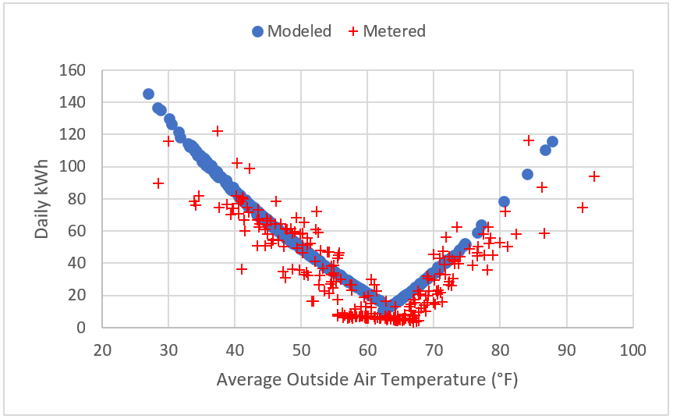
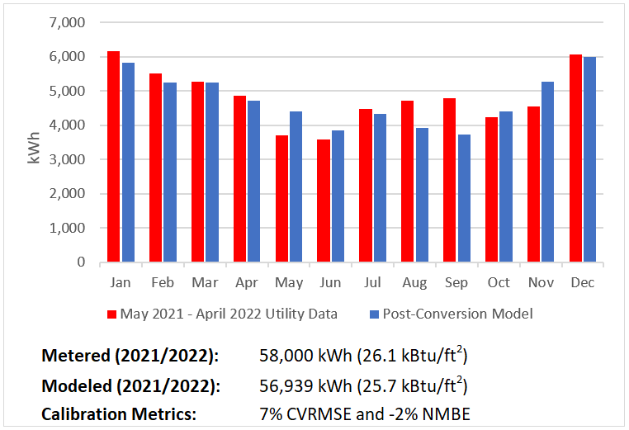
Partnering with Ventacity:
Pilot installations in NW small commercial buildings
Provided technical support
Deployed energy & IAQ metering
Energy modeling (calibrated)
Informal occupant surveys

Slide 16
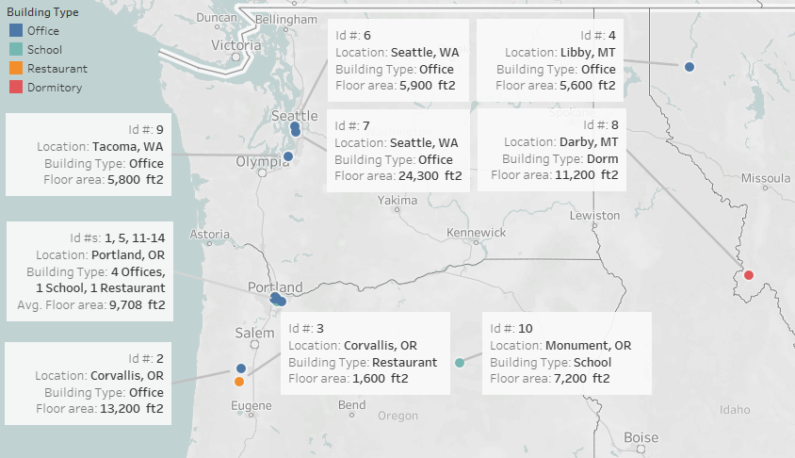
Notes:
Since 2015, NEEA has been involved with 14 projects across OR, WA, MT (I’ve personally been involved from the beginning of 6, starting in 2019)
3 climate zones (CZ 4, 5, 6)
9 offices, 2 school, 2 restaurants, 1 dorm
Ranging from 1,600 sf up to 24,000 sf
Existing systems – 8 were packaged gas RTUs (very common in small commerc. NW building), another 3 were electric RTUs (other 3 were rural sites with residential style furnaces)

Slide 17
Proving the product with field installations
12 pilots using the very high efficiency DOAS approach in small-to-medium commercial buildings across the NW proved significant average energy savings—based on if the building had started with standard code-minimum equipment.
69%
48%
*When compared to a code-minimum version of the existing equipment (often a packaged rooftop unit)
HVAC ENERGY SAVINGS*
WHOLE-BUILDING
ENERGY SAVINGS*
Notes:
In partnership with local utilities and energy efficiency programs, the Northwest Energy Efficiency Alliance (NEEA) conducted a pilot of very high efficiency DOAS conversions in 12 small-to-medium commercial buildings to validate energy savings assumptions and gain a better understanding of the design and installation process.
Even if these pilot buildings had started with standard code-minimum equipment prior to the conversion, modeling still shows significant average energy savings of 69% for HVAC and 48% for the entire building.

Slide 18
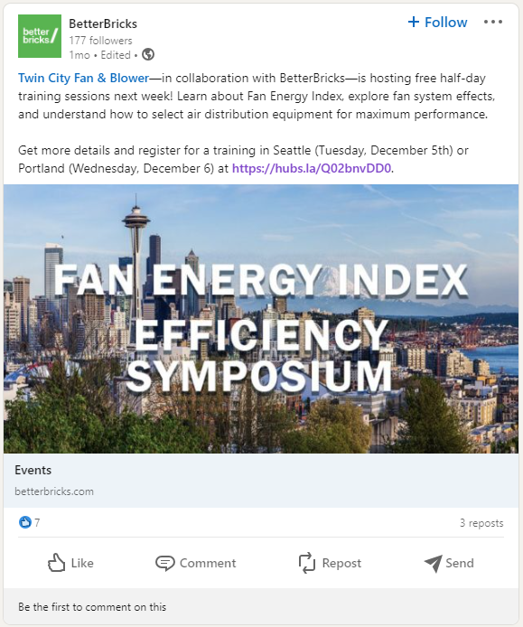
Co-sponsored educational events
NEEA and Twin City Fans
Portland and Seattle, November 2023

Slide 19
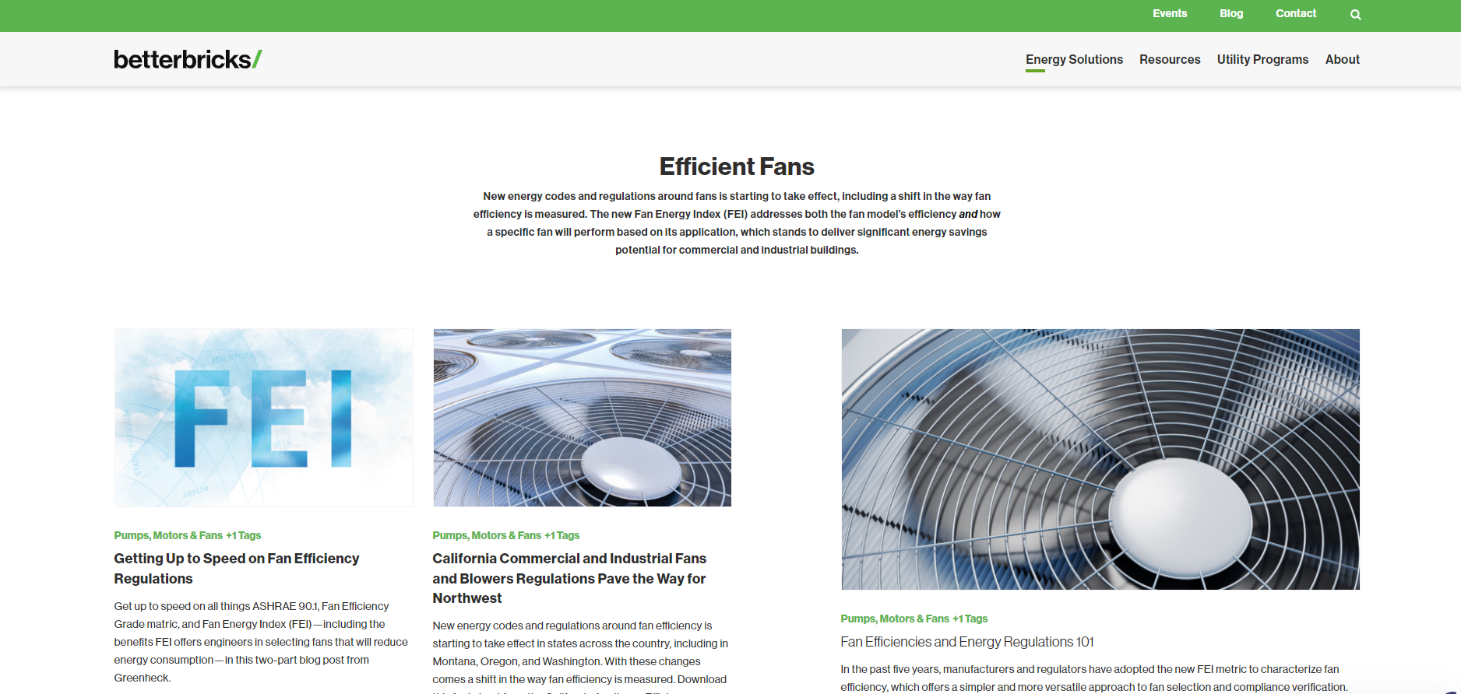
Education resources – betterbricks.com

Slide 20
Published reports and research
https://neea.org/resources-reports

Slide 21
What partnership strategies would help you?
Fill out your card with ideas!

Slide 22
Nicky Dunbar
NEEA Senior Codes and Standards Engineer
503-688-5457 │ ndunbar@neea.org

