Slide 1
Air-Cooled Chillers (ACCL) and Water-Cooled Chillers (WCCL) Certification Program Update
2023

Slide 2
Updated Sections of the ACCL and WCCL OMs (2023)
Effective May 28, 2023
Section 1.1 – Applicable Rating Standards
Reference 550/590-2023 and 551/591-2023
Reference EN Standards 14511:2022 and 14825:2022
Section 3.2 – Testing Standard
Uncertainty analysis per ASHRAE Standard 30-2019 Section 6.7.3 is recommended but not required.
Section 3.7.5.5 – Alternate Certification
Moved from Certified Selections (Section 3.7.4) to Non-Certified Selections (Section 3.7.5)
Section 3.7.7 – Primary Catalog / Selection Rating Application Language
Allow software to be published in Mandarin Chinese
Section 3.9.1 – Options Following First Sample Failure
2nd Sample units must have the same country of origin as 1st sample.

Slide 3
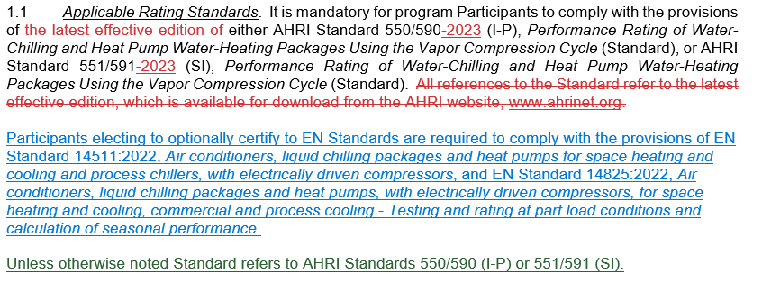
Section 1.1 – Applicable Rating Standards
What: Reference standards by year and add reference to EN standards.
Why: Referencing standards by version (year) instead of “latest edition” provides increased clarity and stability for program requirements.
Notes:
One Participant has re-rated the same BMG for two consecutive years.

Slide 4
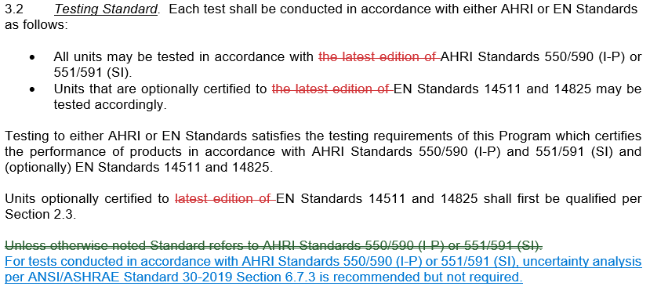
Section 3.2 – Testing Standard
What: Uncertainty analysis per ASHRAE 30 section 6.7.3 is recommended but not required.
Why: Additional education and resources are needed before laboratories and participants can comply.
Notes:
One Participant has re-rated the same BMG for two consecutive years.

Slide 5
Section 3.7.5.5 – Alternate Certification
What: Moved from Certified Selections (3.7.4) to Non-Certified Selections (3.7.5)
Why: Selections cannot be considered AHRI certified if they meet the requirements of a different standard or certification program but not AHRI’s requirements.
Notes:
One Participant has re-rated the same BMG for two consecutive years.

Slide 6
Section 3.7.7 – Primary Catalog / Selection Rating Application Language
What: Allow selection software in Mandarin Chinese if it is a direct translation from the English version.
Why: Market need.
Notes:
One Participant has re-rated the same BMG for two consecutive years.

Slide 7
Section 3.9.1 – Options Following First Sample Failure
What: 2nd sample units must have the same country of origin as the 1st sample.
Why: Country of origin is a critical selection criteria.
Notes:
One Participant has re-rated the same BMG for two consecutive years.

