Slide 1
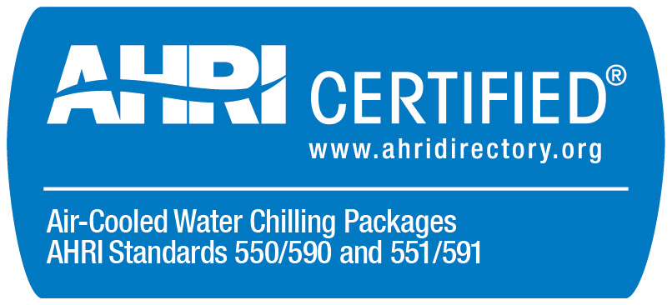
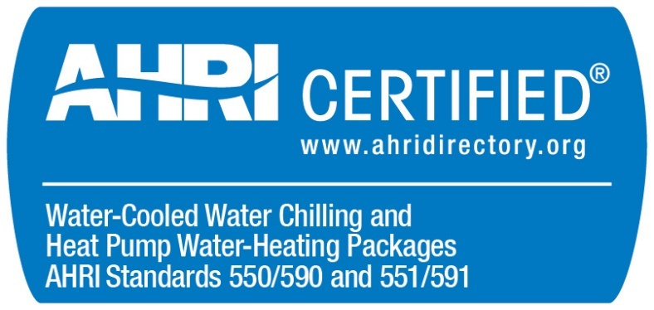
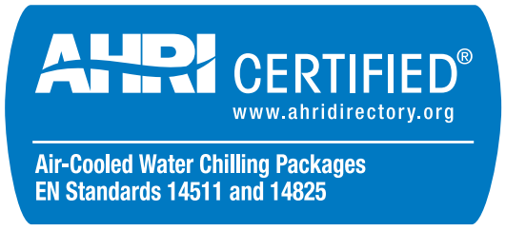
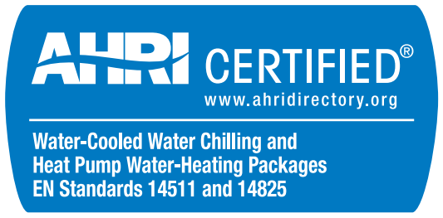
Air-Cooled Chillers (ACCL) and
Water-Cooled Chillers (WCCL) Certification Program Update
2018

Slide 2
Updated Sections of the ACCL and WCCL OMs (2018)
Effective January 1, 2018
  Removal of Unit Listing Types (Packaged and Configurable)
  Scope Revision: Addition of EN Standards 14511 and 14825
  Testing Revision: Allow participants in the laboratory during in-house testing.
  Testing Timeline: Set specific milestones for testing. coordination.
  2nd Sample Requirement: Similar published performance (+/- 10% capacity and 0 to 5% improved full-load efficiency and IPLV)
  Test Stand Directory: Public list of all approved test stands with and a six year maximum Test Stand capacity check.
  New Product Introduction Directory: Defined fields

Slide 3

Removal of Unit Listing Types (Packaged and Configurable)
Why: Removed complexity in scope determination.
What: Deleted Section 1.2.5 and updated Note a of Table 1 to read
  Effective July 1, 2018: Updates to requirements for Primary Catalog / Selection Rating Application Output Reports, including scope determination based on Table 1, Note a.
Notes:
One Participant has re-rated the same BMG for two consecutive years.

Slide 4
Scope Revision: Addition of EN Standards 14511 and 14825
Why: Allow AHRI Certification to EN Standards
What: Included optional Certification to EN Standards 14511 and 14825.
  No additional testing: Test to one standard, certify to all.
  All units certified to EN Standards shall also be certified to AHRI Standards.
  EN Certification Statement (Section 3.7.6.4) required for all units certified to EN Standards.
  AHRI Directory Field added showing certification to EN Standards.
  2nd Sample tests use the same standard as the 1st Sample.
Notes:
One Participant has re-rated the same BMG for two consecutive years.

Slide 5
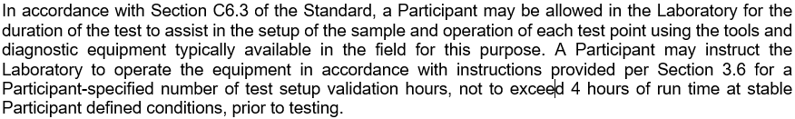
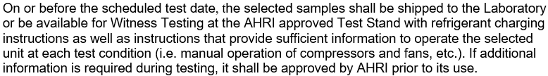
Testing Revision: Allow participants in the laboratory during in-house testing.
Why: Harmonize requirements for in-house and witness testing
What:
  Participants may operate their unit in the 3rd party lab.
  Prior to testing Participants are required to provide sufficient information to operate the selected unit at each test condition.
Notes:
One Participant has re-rated the same BMG for two consecutive years.

Slide 6
Testing Timeline: Specific milestones for testing coordination
Why: Allow all testing to be completed each year.
What: Set Specific milestones for each test (Section 3.6).
90 days or before Scheduled Test Date
45 days or before Scheduled Test Date
30 days or before Scheduled Test Date
AHRI sends Participant selection letter
Before Scheduled Test Date
Participant begins testing of unit at testing location
Participant sends AHRI Production Availability
7 days after selection letter
Participant sends AHRI a completed DS-2 Form and matching performance output sheet
AHRI sends Participant notification for Scheduled Test Date and BMG list
Notes:
One Participant has re-rated the same BMG for two consecutive years.

Slide 7
2nd Sample Requirement
Why: Align 2nd Sample Requirements with other AHRI Programs
What: 2nd Sample is required to be
  Similar published performance (+/- 10% capacity and 0 to 5% improved full-load efficiency and IPLV.IP/IPLV.SI or NPLV.IP/NPLV.SI)
  Within the same BMG as the 1st Sample.
Notes:
One Participant has re-rated the same BMG for two consecutive years.

Slide 8
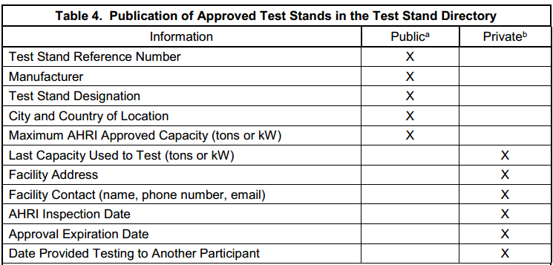
Test Stand Directory
Why: Removed complexity in scope determination.
What: Public list of all approved test stands.
  Maximum Test Stand capacity is checked every 6 years.
Notes:
One Participant has re-rated the same BMG for two consecutive years.

Slide 9
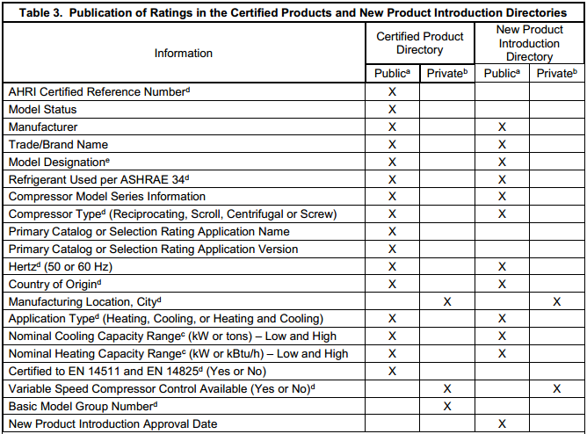
New Product Introduction Directory: Defined fields
Notes:
One Participant has re-rated the same BMG for two consecutive years.

