Slide 1
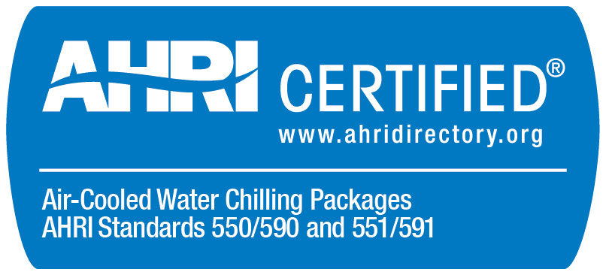
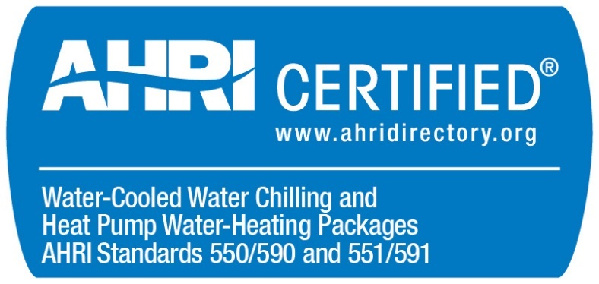
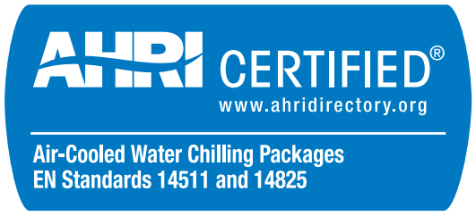
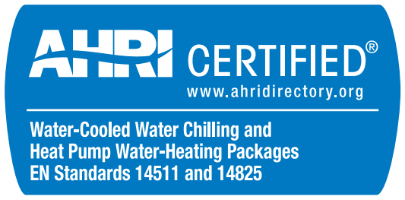
Air-Cooled Chillers (ACCL) and Water-Cooled Chillers (WCCL) Certification Program Update
2022

Slide 2
Updated Sections of the ACCL and WCCL OMs (2022)
Effective January 1, 2022
Section 1.3.1 – Optional Certification
Updated requirements
Examples added in Appendix A (WCCL) / Appendix B (ACCL)
Section 3.5.1 – Test Stand Approval
Allow Standalone Facility Inspections at NPLV conditions for units that cannot run at IPLV conditions.
Section 9.2 – Changes to Directory Listings
Require participants to provide an explanation of proposed changes instead of submitting DS1 form.
Add lists of Directory fields that require AHRI approval or are not editable.

Slide 3
Section 1.3.1 – Optional Certification
Why: It should be clear from looking at the AHRI Directory and a software output report exactly what is certified and what is not. If a product is not certified, it must be differentiable from certified products in the Directory.
What: Updated requirements (see below) and added examples in Appendix A (WCCL) / Appendix B (ACCL).
Notes:
One Participant has re-rated the same BMG for two consecutive years.

Slide 4
Section 3.5.1 – Test Stand Approval
Why: Align with existing allowances for certification tests and facility inspections conducted concurrently with a certification test.
What: For facility inspections not conducted with a certification tests, allow units that are unable to operate at Standard Rating Conditions to be run at NPLV conditions.
Notes:
One Participant has re-rated the same BMG for two consecutive years.

Slide 5
Section 9.2 - Changes to Directory Listings – DS1 Form
Why: DS1 form is unnecessary because AHRI can see the same information when Directory changes are submitted.
What: Remove requirement to submit DS1 form. Instead require an explanation of proposed changes.
Notes:
One Participant has re-rated the same BMG for two consecutive years.

Slide 6
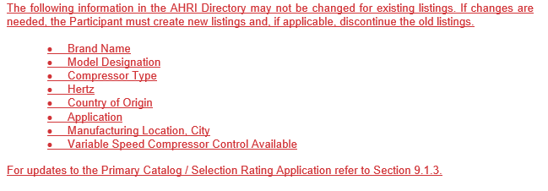
Section 9.2 - Changes to Directory Listings – List of Fields
Why: Provide transparency and help participants better understand the Directory update and approval process
What: Add a list of Directory fields requiring AHRI approval for edits and a list of fields that are not editable for existing listings.
Notes:
One Participant has re-rated the same BMG for two consecutive years.

